Slide 1
observable
characteristic
compare
similarity
difference

Slide 2
Something observable is something that we can see or describe using our senses.
A characteristic is a feature or quality of something that we can see or use our other senses to observe.
We compare things by looking at what is the same and what is different.
A similarity is something two or more objects have in common.
A difference between two objects or things is something that is not similar or the same about them.

Slide 3

Comparing characteristics of living things
Observable characteristics
Comparing living things
Identifying living things

Slide 4

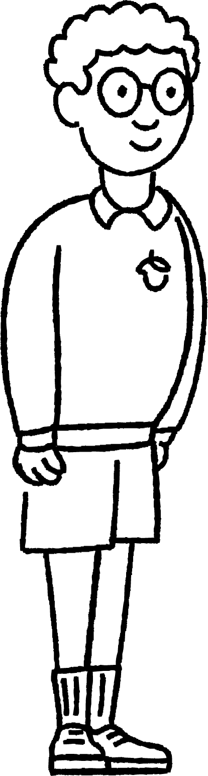

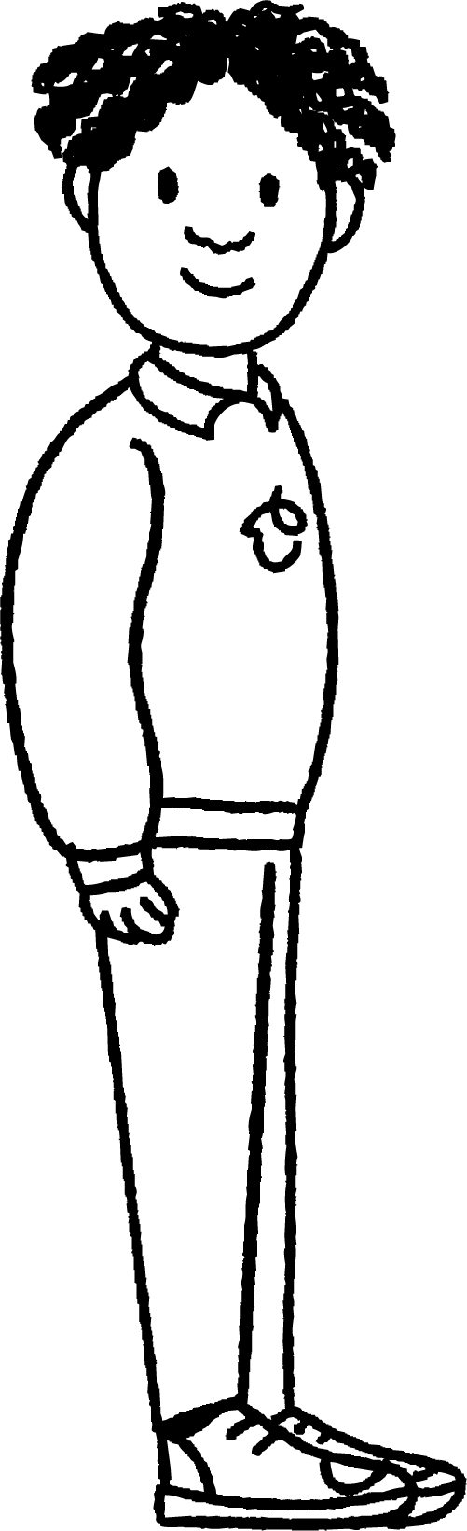
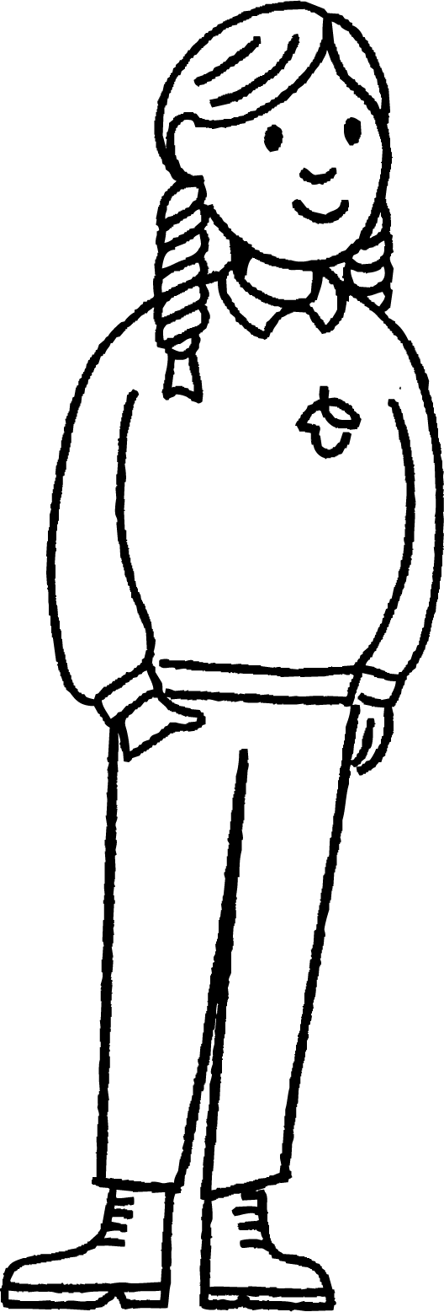
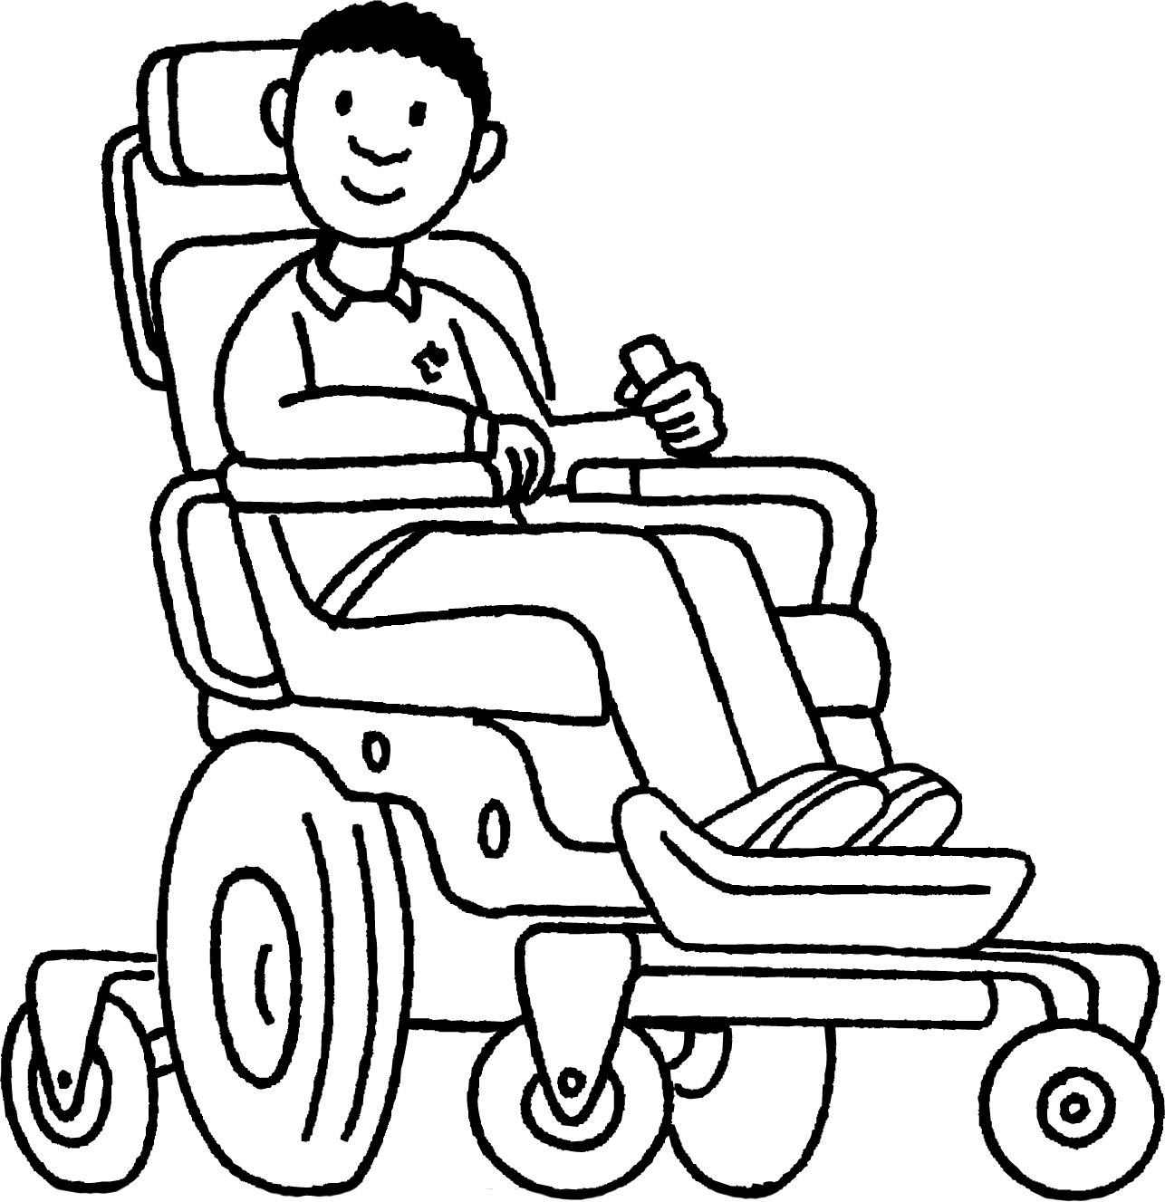
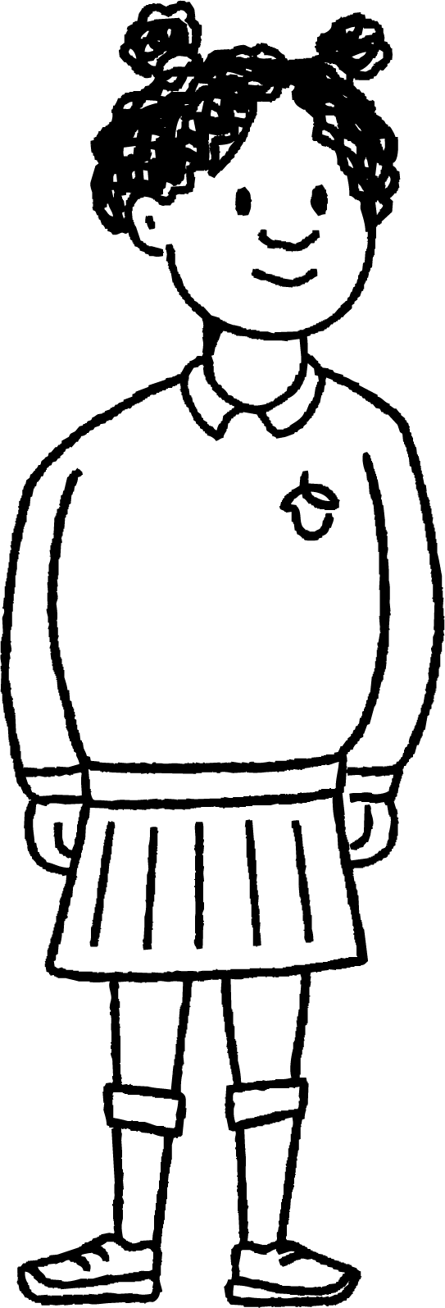
Observable characteristics
Sofia has been learning about classifying and grouping living things.
Sofia
She wants to practise her skills at putting things into groups using her friends.
What characteristics could she use to divide her friends into groups?
Sofia’s friends

Slide 5


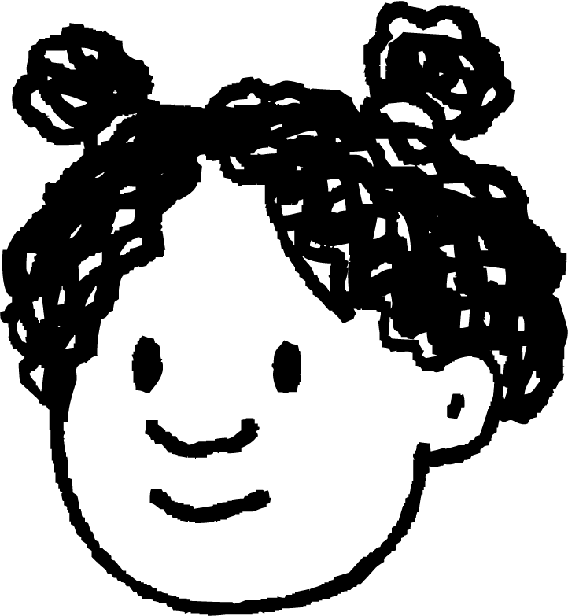

Observable characteristics
You could sort us by our hair colour.
You could put us into groups based on our eye colour.
You could put us into groups of boys and girls.
Aisha
Izzy
Lucas
These are all observable characteristics.

Slide 6
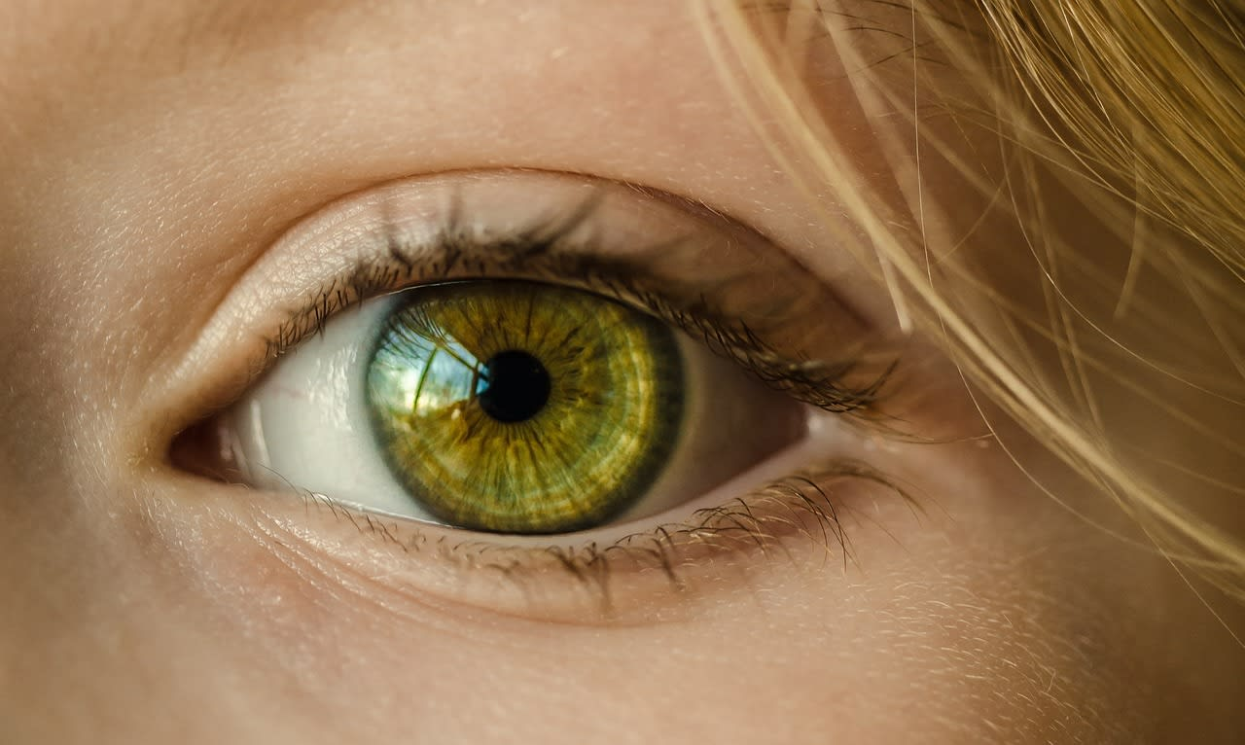
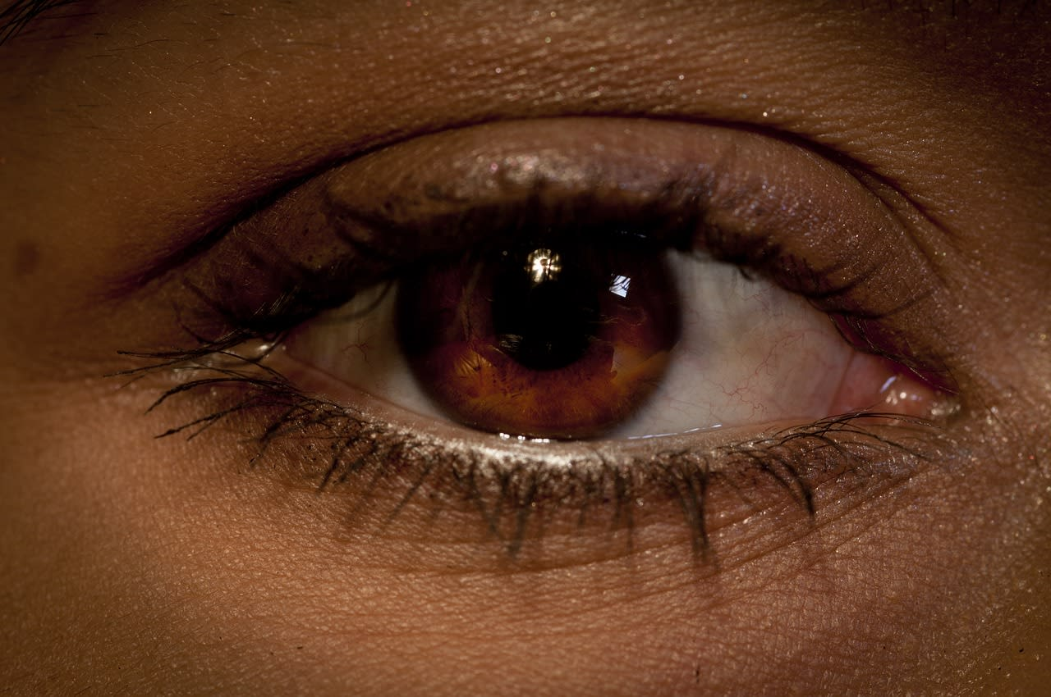
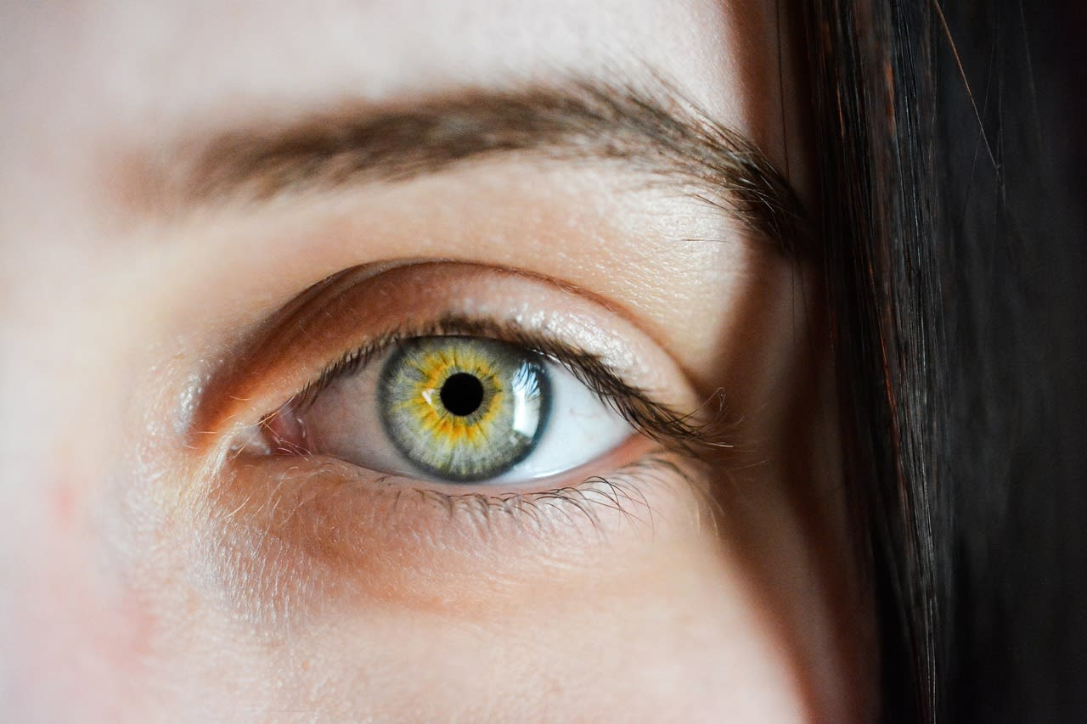
Observable characteristics
An observable characteristic is a feature or property of a living thing that we can see or use our other senses to observe.
This can include information about colour, size, shape or structure.
Eye colour is an example of an observable characteristic.

Slide 7

Observable characteristics
Which of these are observable characteristics of an object?
its colour
how much it costs
its shape
its size

Slide 8
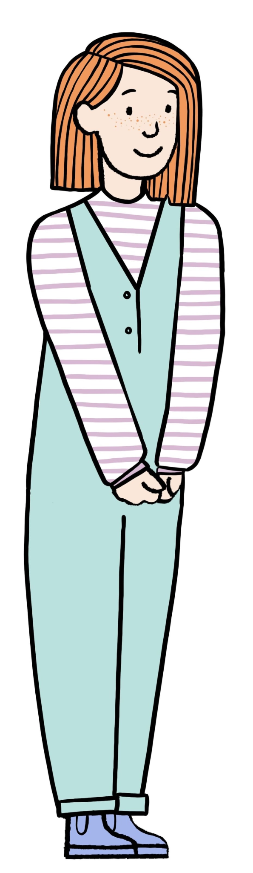
Observable characteristics
Some observable characteristics of Alex’s mum are:
she has ginger hair
she has straight hair
she has blue eyes
she has freckles
Alex’s mum

Slide 9
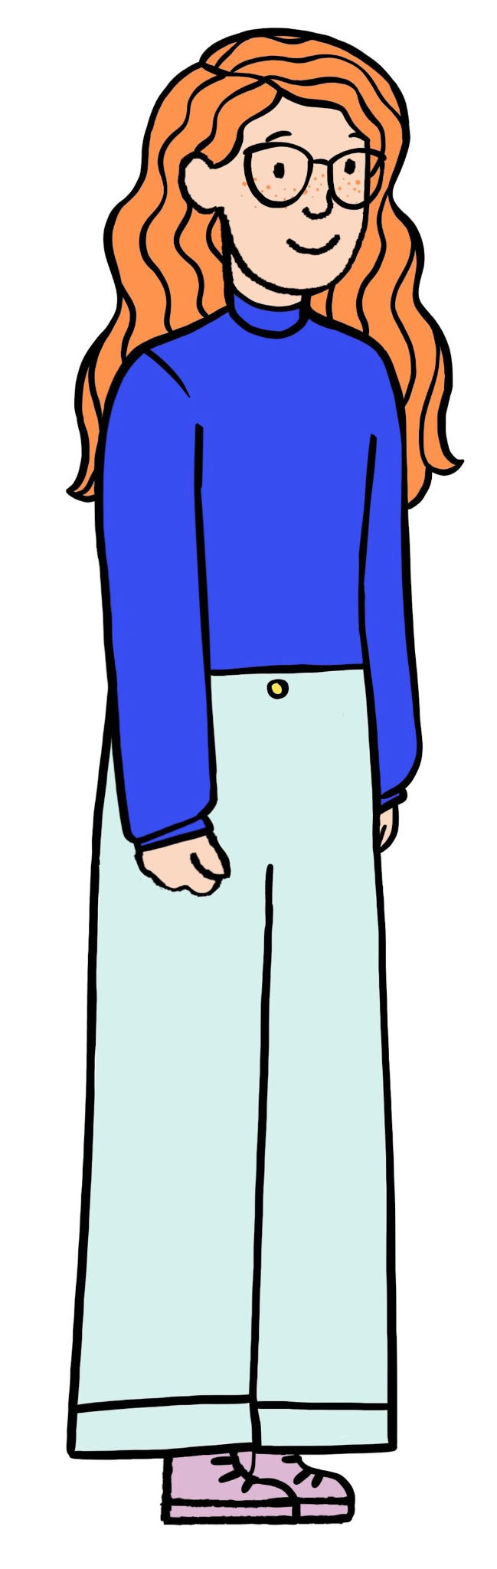
Observable characteristics
Some observable characteristics of Alex’s older sister are:
she has ginger hair
she has curly hair
she has green eyes
she has freckles
Alex’s older sister

Slide 10
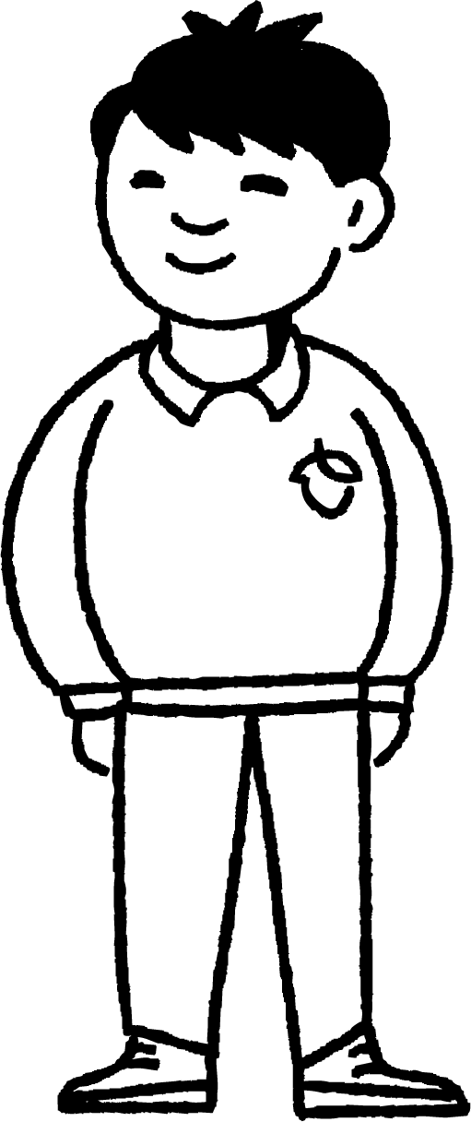
Observable characteristics
Which of these are observable characteristics of Jun?
he has dark hair
he has a pet goldfish
he likes cheese sandwiches
his name is Jun
Jun

Slide 11

Observable characteristics
Sofia has sorted herself and her friends into groups according to an observable characteristic.
children with curly hair
children with straight hair
Someone is in the wrong group. Can you see her mistake?

Slide 12
Observable characteristics
Alex should be in the first group because he has curly hair.
children with curly hair
children with straight hair
When sorting things into groups, the groups do not need to be equal in size.

Slide 13
Observable characteristics
How has Sofia sorted her friends into groups?
group 1
group 2
boys and girls

Slide 14
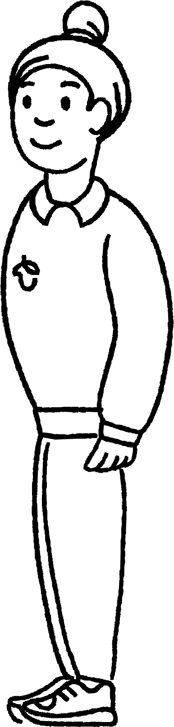


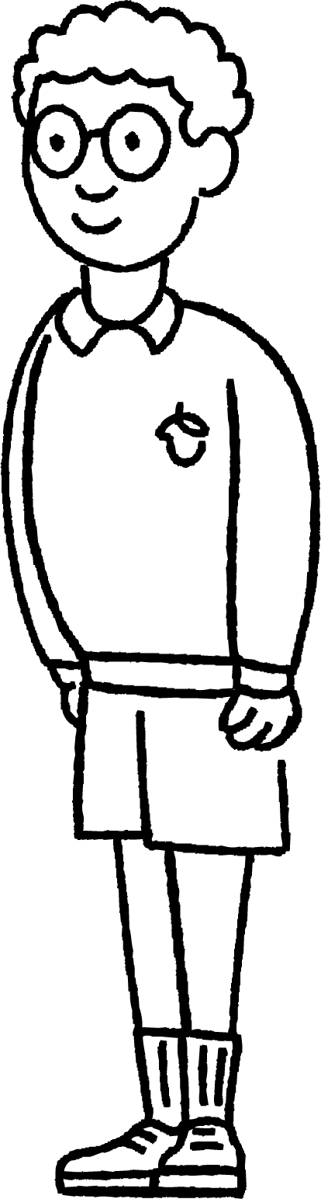
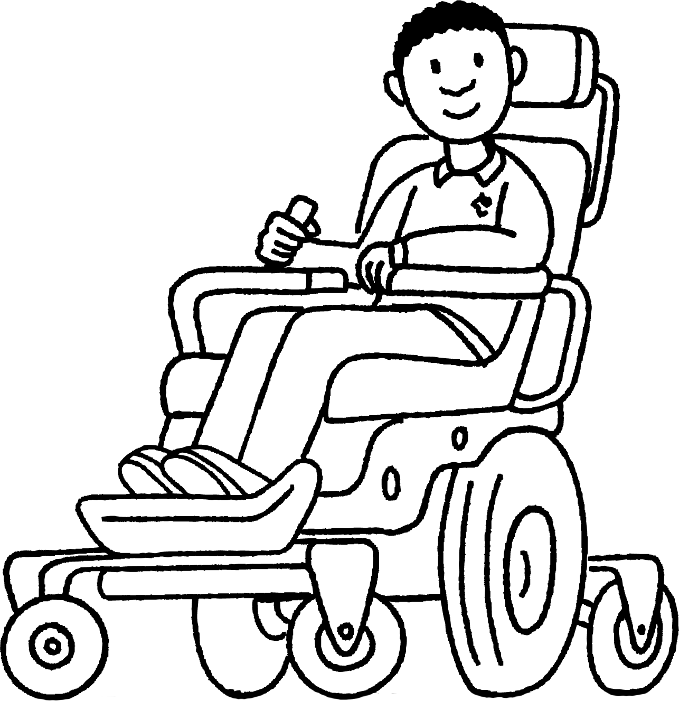
Observable characteristics
1. Choose six people in your class, or the people below, and sort them into groups using observable characteristics.
Find at least two different ways to sort them.
Andeep
Sofia
Alex
Jun
Aisha
Lucas

Slide 15



Observable characteristics
1. Choose six people in your class, or the people below, and sort them into groups using observable characteristics.
Here are some ways you could have sorted your people.
girls
boys
Izzy
light coloured hair
dark coloured hair

Slide 16
Comparing characteristics of living things
Observable characteristics
Comparing living things
Identifying living things

Slide 17
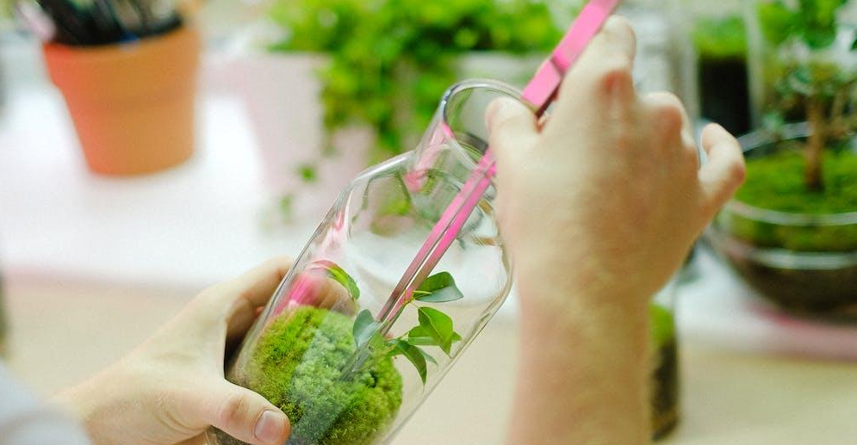
Comparing living things
When we compare things, we look at their similarities and differences.
Scientists use observable characteristics to compare living things. This helps them to sort living things into groups and work out what they are.
observing a plant

Slide 18
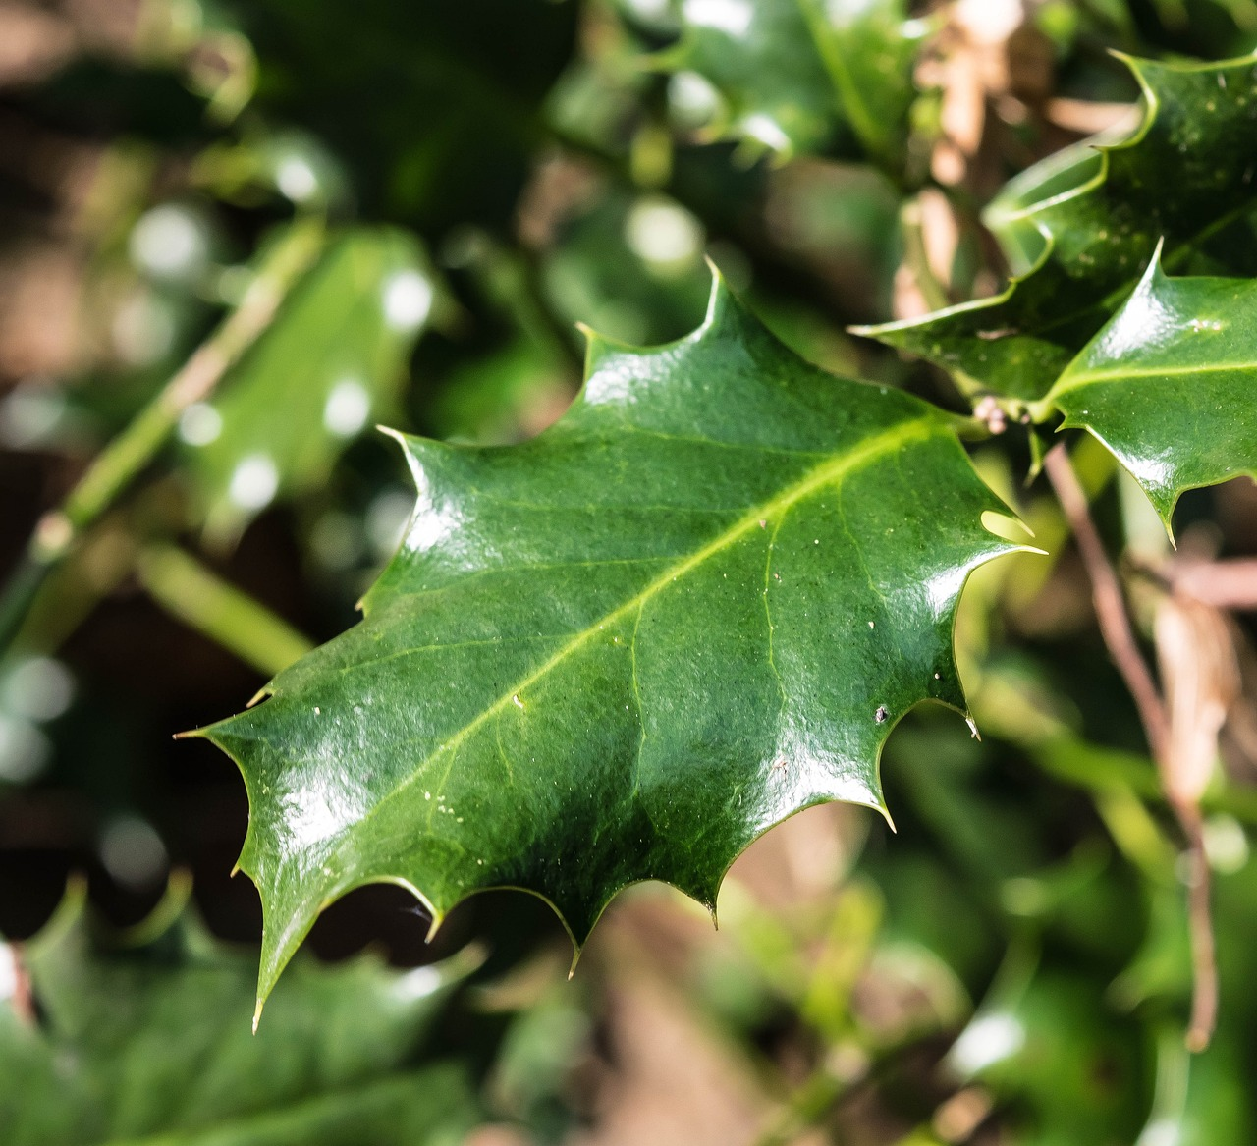
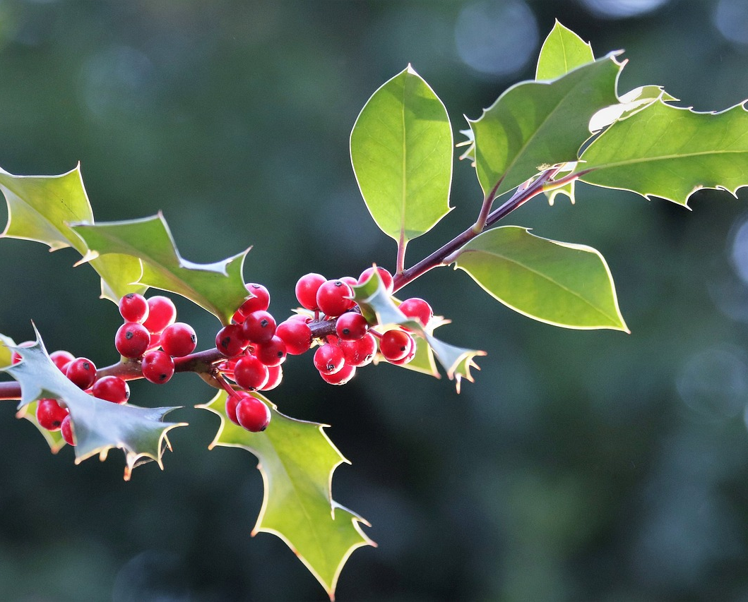
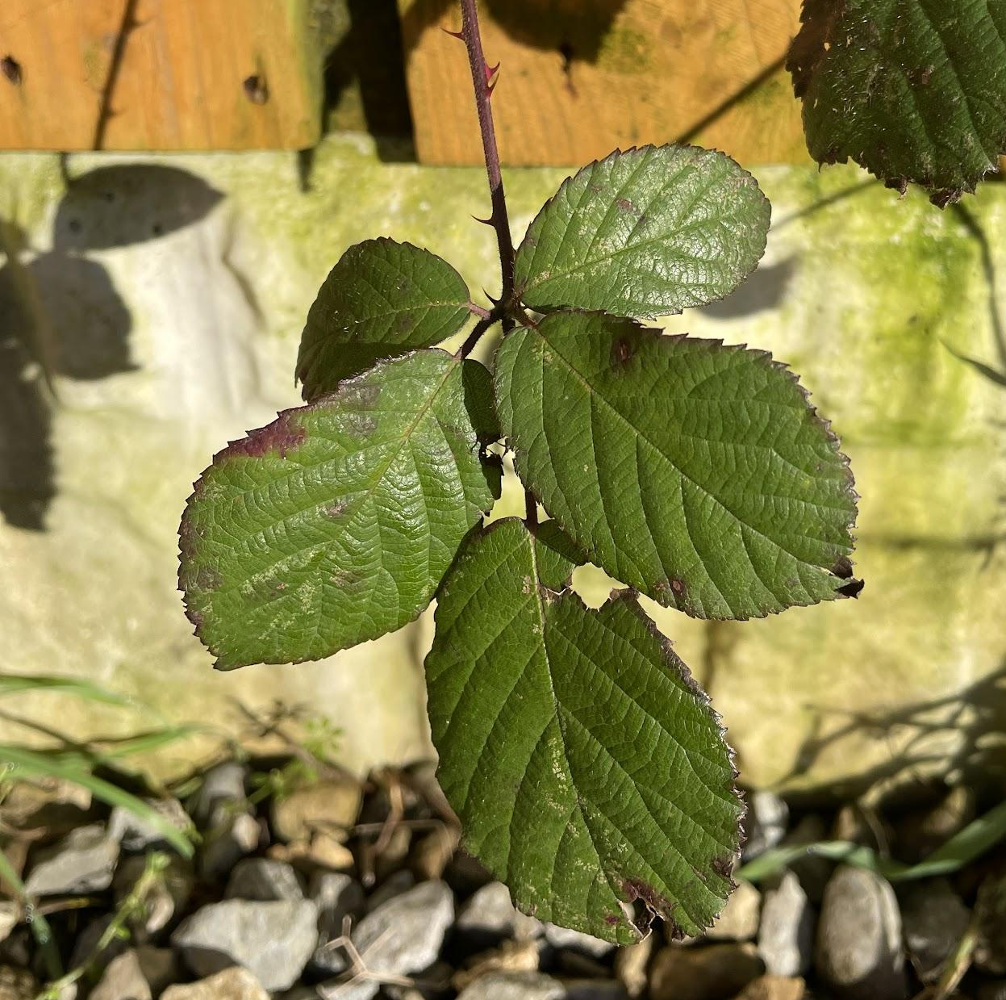
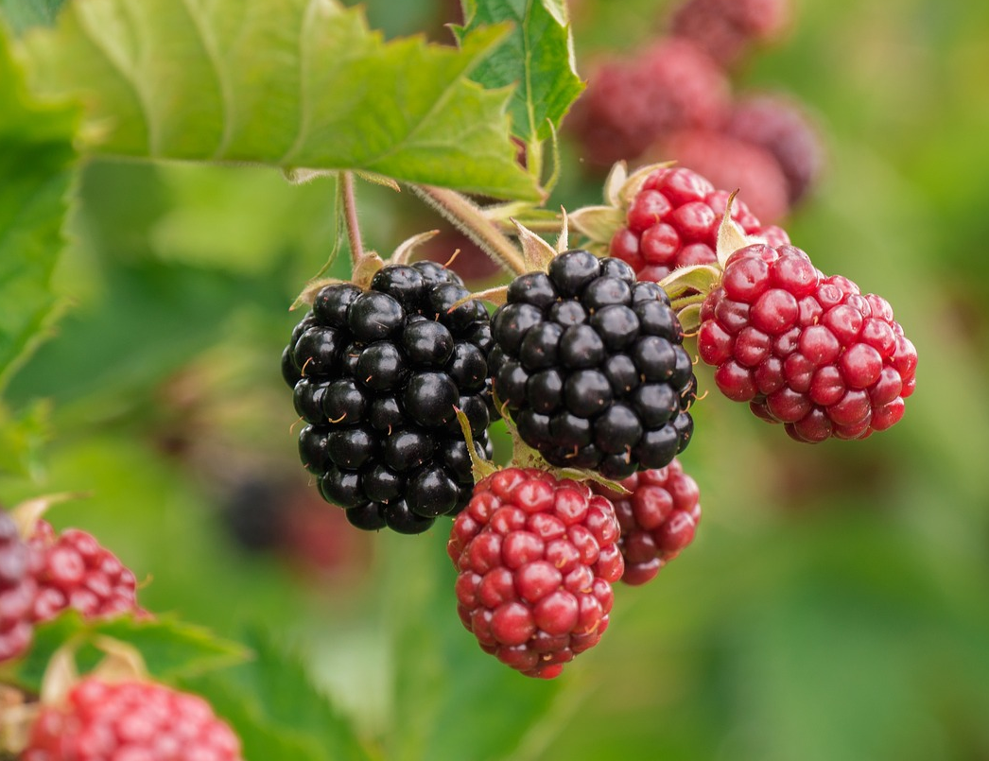
Comparing living things
What similarities and differences can you see between these two types of plant?
holly bush
bramble

Slide 19


Comparing living things
I observed some similarities. They both have green leaves and berries.
I observed some differences. The berries are different colours and shapes. The holly has spiky, waxy leaves and the bramble doesn’t.
Aisha
Sam
holly bush
bramble

Slide 20
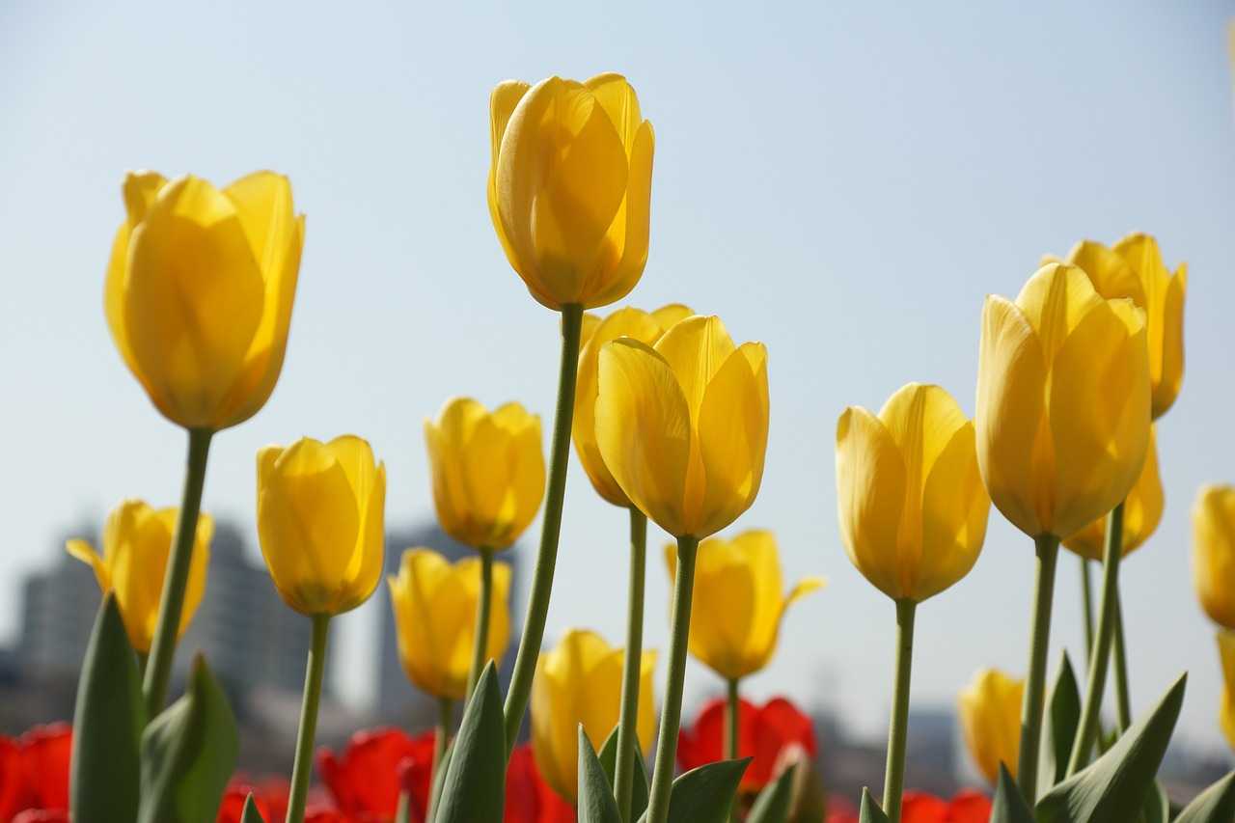
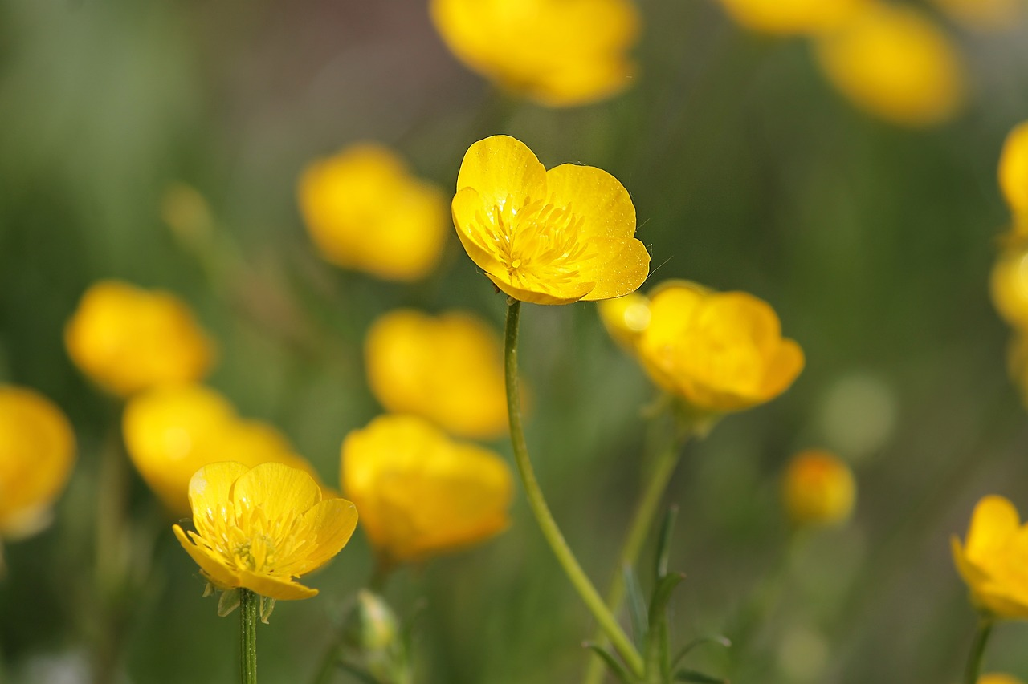
Comparing living things
The flowers on these plants are different to each other.
The flowers on these plants are similar to each other.
Aisha
Izzy
Who do you agree with?
tulips
buttercups

Slide 21
Comparing living things
Both children are correct.
The flowers are similar to each other as they both sit at the top of long, green stems and they both have yellow petals.
The flowers have differences in their shapes and sizes.
tulips
buttercups

Slide 22
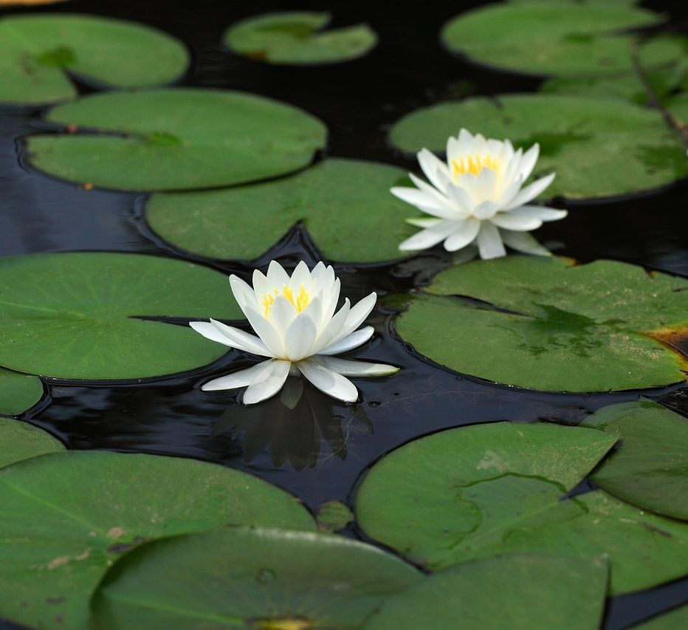
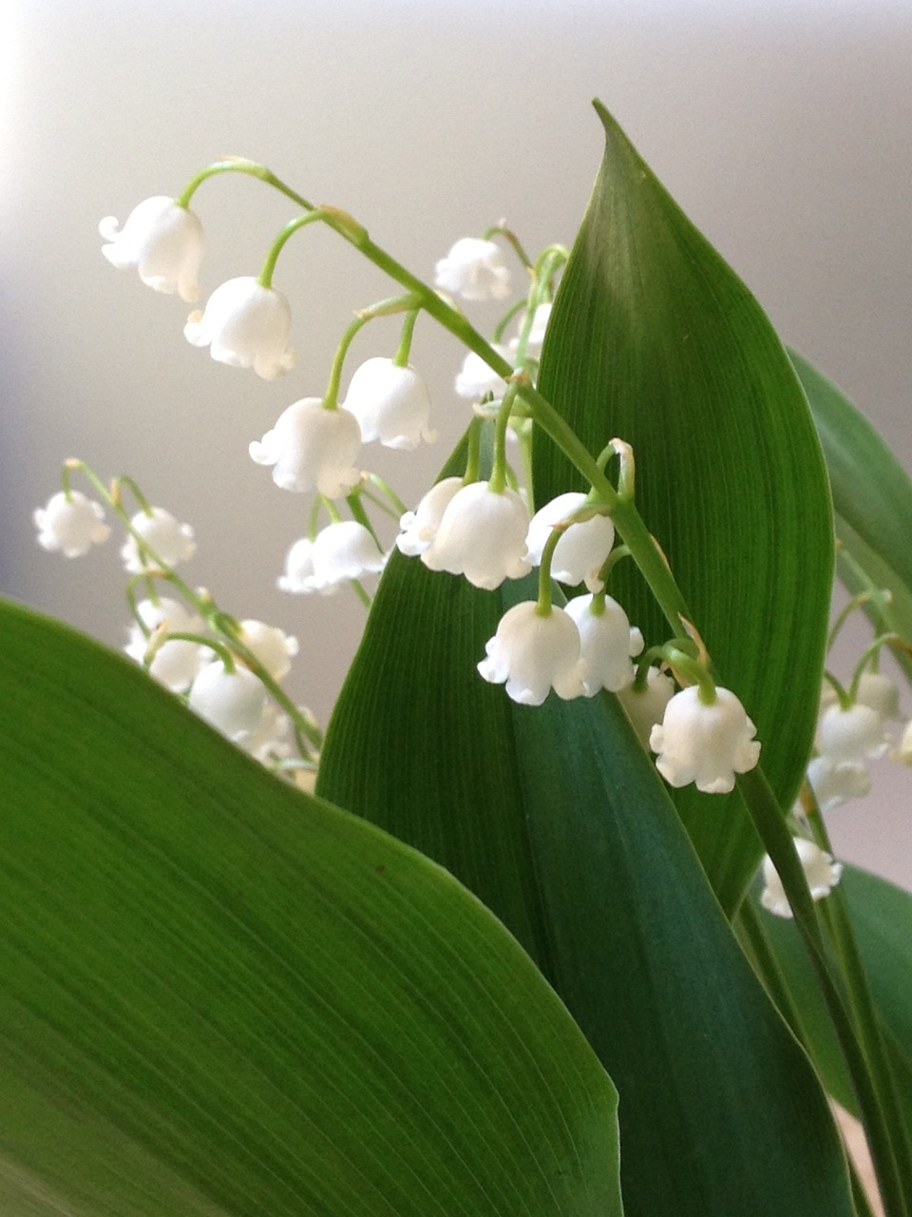
Comparing living things
Which of these things are similar and which are different between these two plants?
leaf shape
different
leaf colour
similar
flower shape
different
water lily
lily of the valley
flower colour
similar

Slide 23
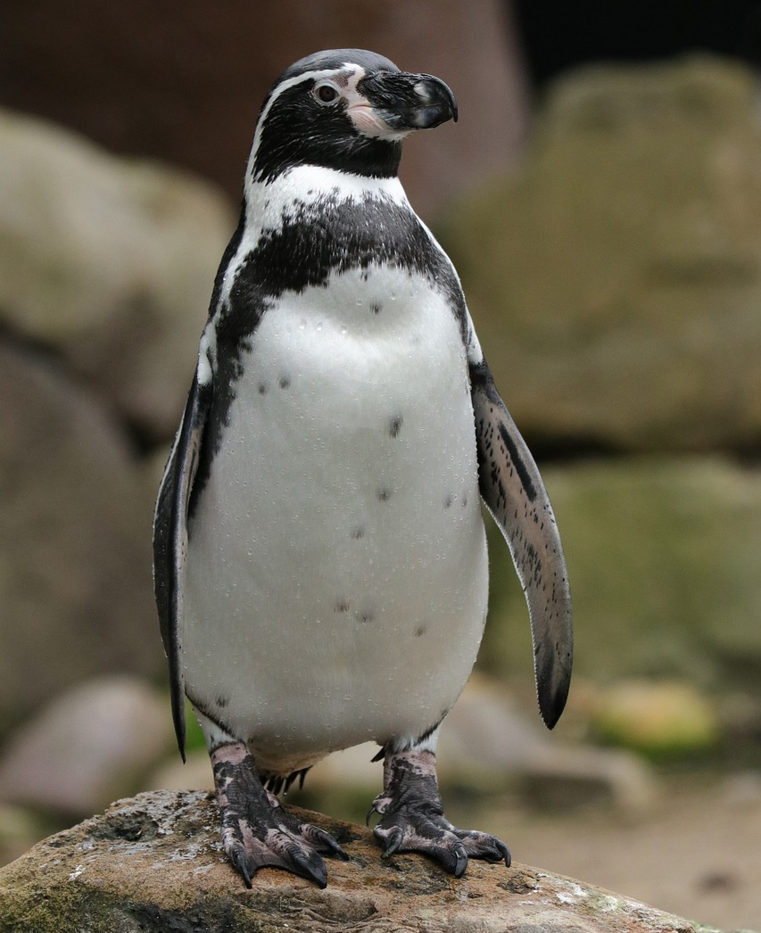
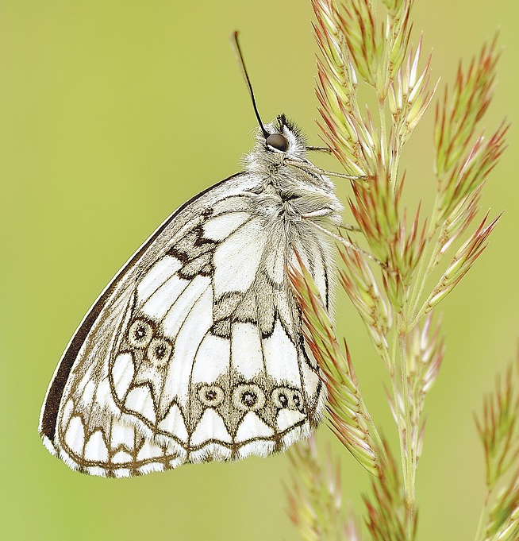
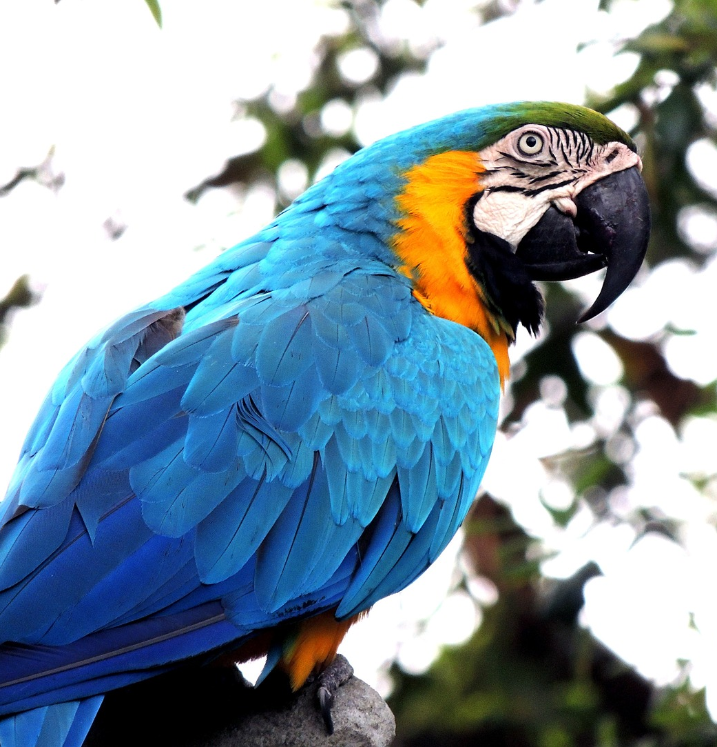
Comparing living things
Which of these is the odd one out? Think about what is the same and what is different about each one.
penguin
butterfly
macaw

Slide 24
Comparing living things
I think it’s the penguin because it can’t fly.
penguin
butterfly
macaw
Aisha
The butterfly is the odd one out because it’s the only one that’s not a bird.
I think it’s the macaw because the other two are just black and white.
What do you think?
Lucas
Izzy

Slide 25
Comparing living things
Which of these is not an observable characteristic we could use to compare animals?
the shape of their tail
their body covering
their colour
the date they were born

Slide 26
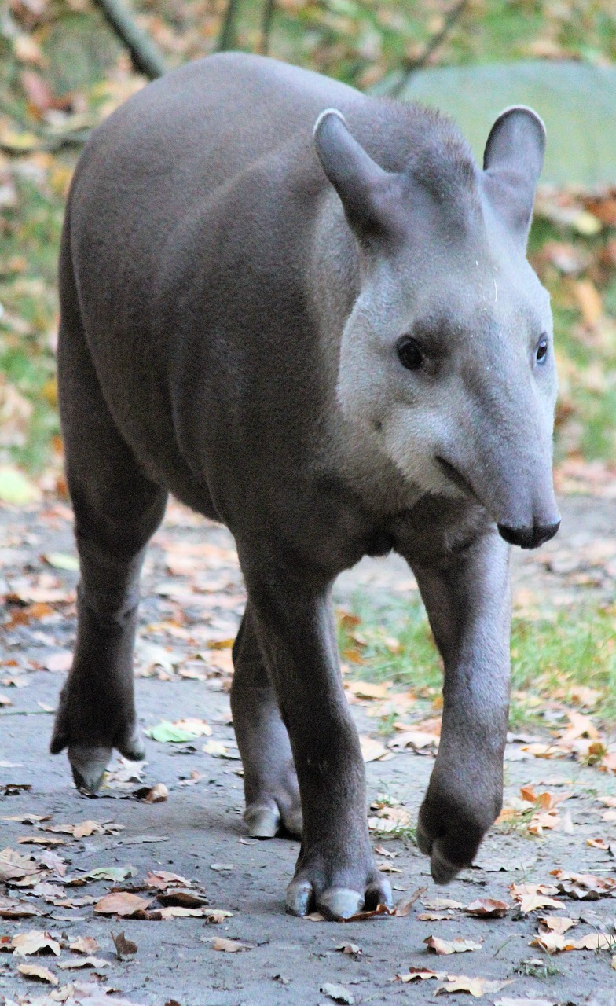
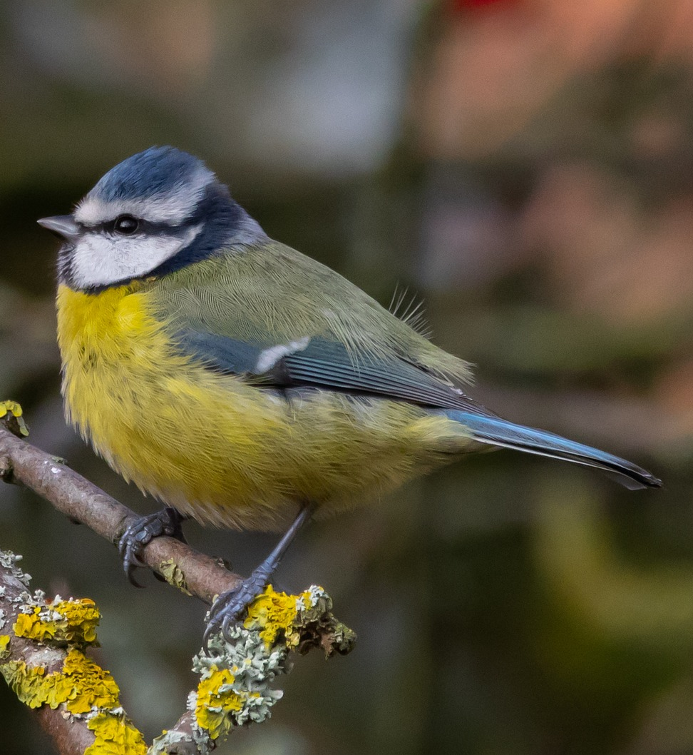
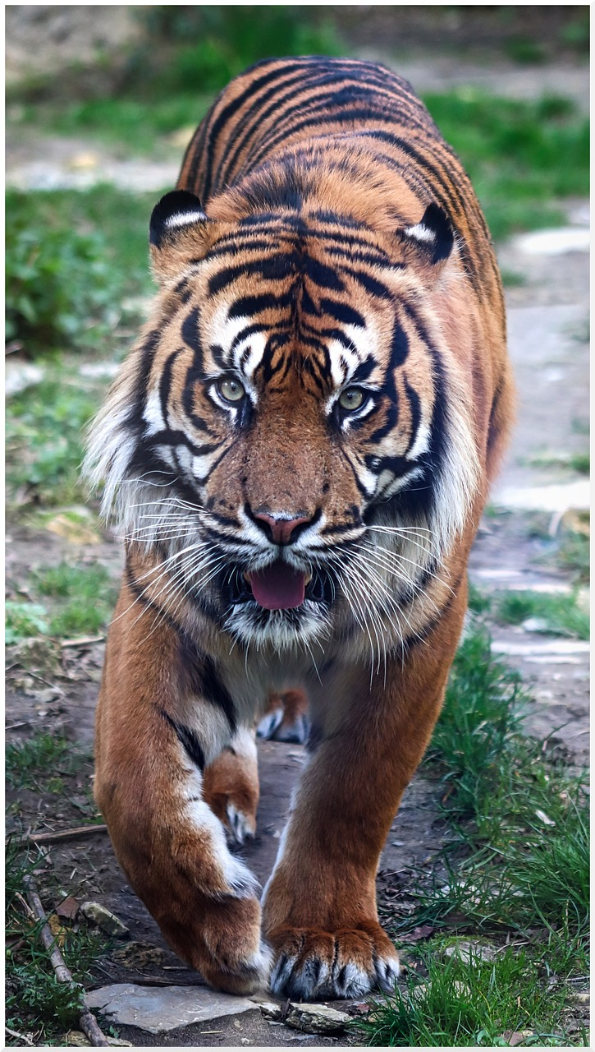
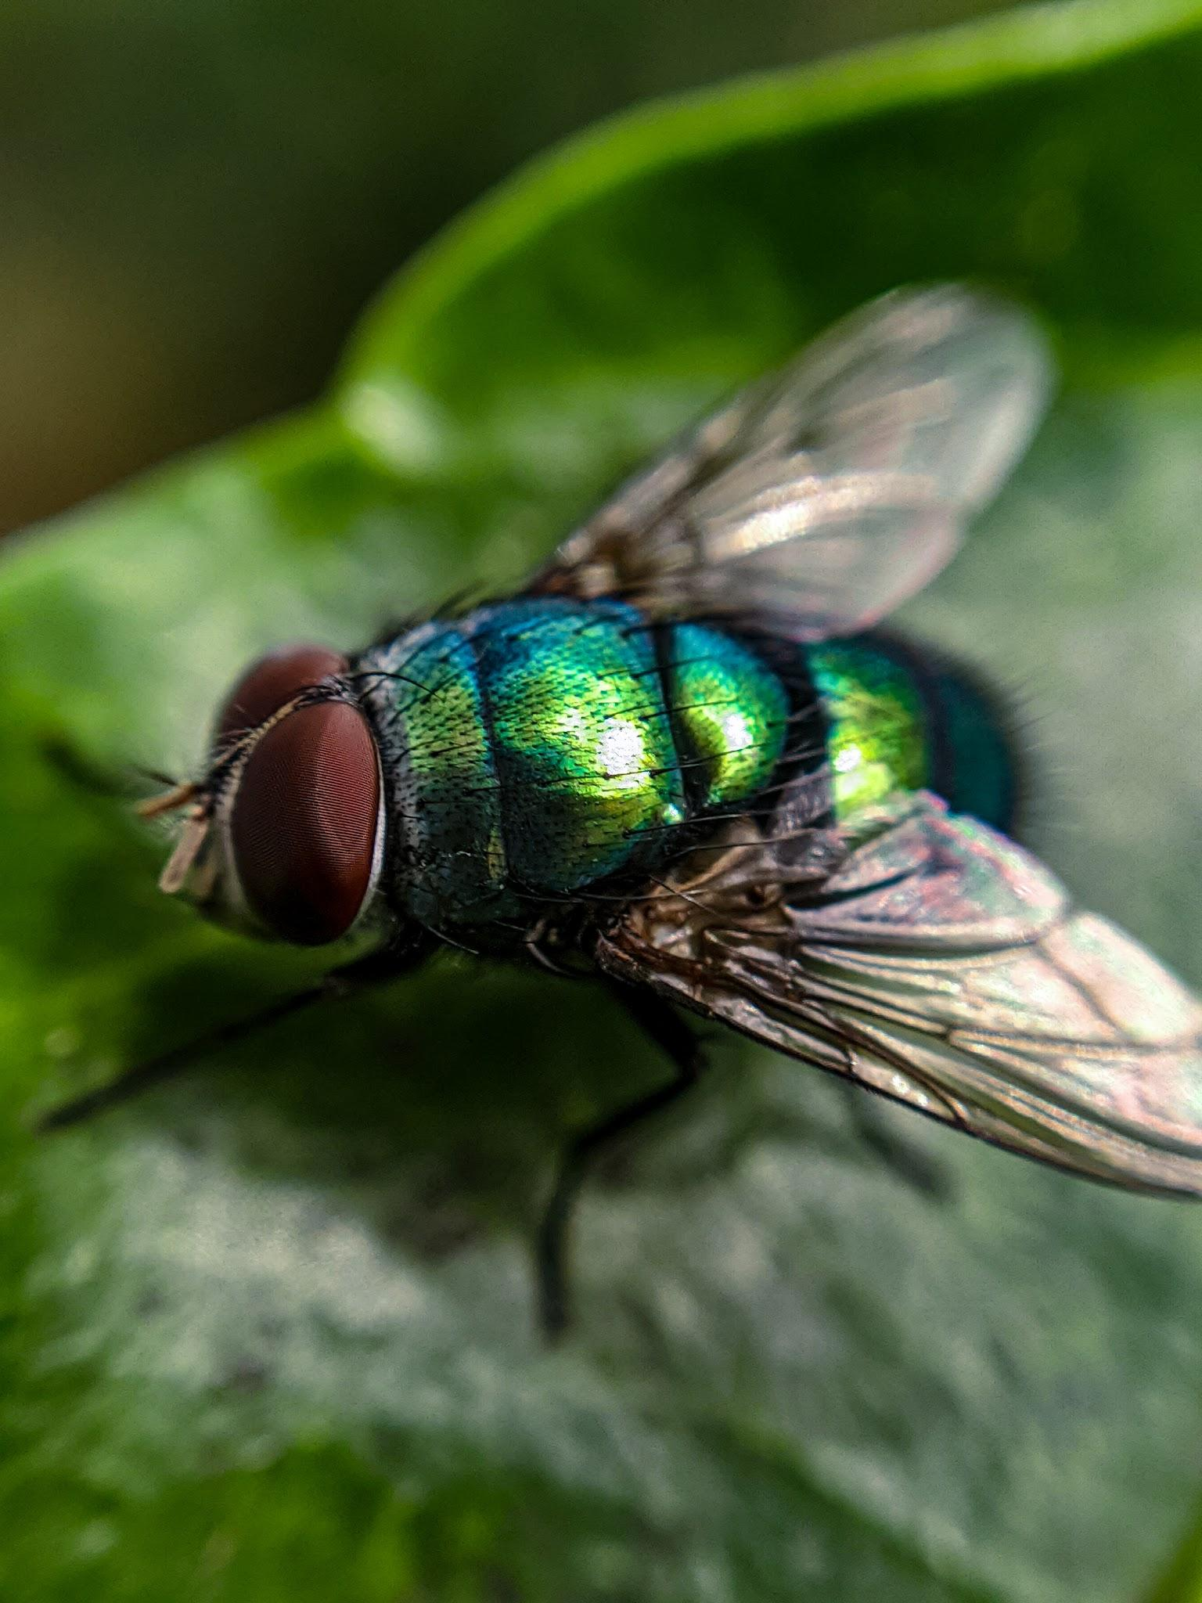
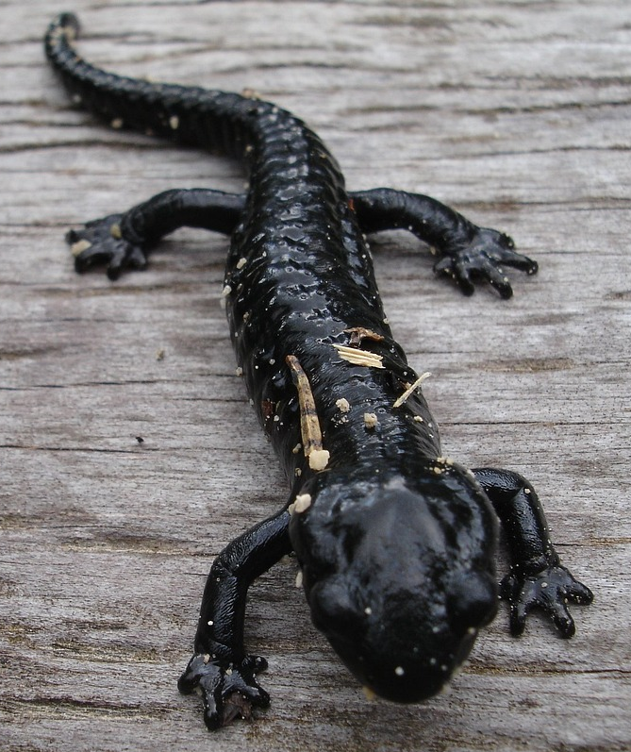
Comparing living things
Comparing living things
Comparing living things
Choose three animals and complete the comparison table. You can pick animals that you are familiar with or use these pictures.
Choose your own characteristics to compare in the empty boxes in the first column.
tapir
blue tit
tiger
fly
salamander

Slide 27
Comparing living things
Comparing living things
Comparing living things
key facts | animal 1 | animal 2 | animal 3
colour
how does it move?
body covering

Slide 28
Comparing living things
Choose three animals and complete the comparison table.
key facts | fly | blue tit | tiger
colour | green | blue, black, yellow, white | black, white, orange
how does it move? | walks, flies | walks, flies | walks, runs, climbs
body covering | very short hairs | feathers | fur
number of legs | 6 | 2 | 4
tail | no tail | thin, made of feathers | long, has black rings
How are the animals you chose similar and different to mine?
Lucas

Slide 29
Comparing characteristics of living things
Observable characteristics
Comparing living things
Identifying living things

Slide 30
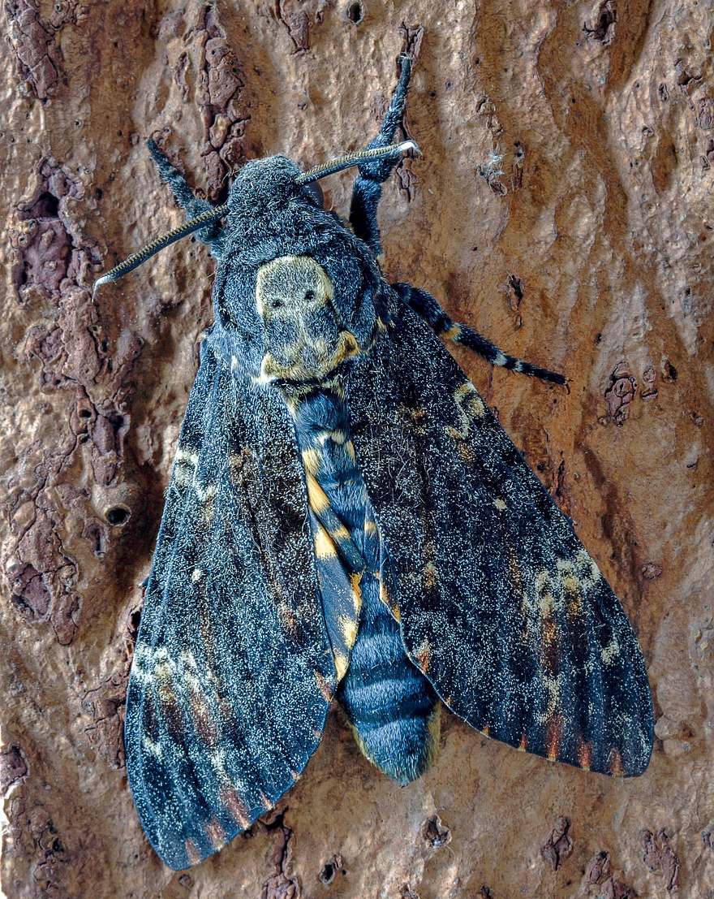
Identifying living things
Scientists can compare similarities and differences between living things to help us work out whether they belong in certain groups.
Alex has found an animal in his backyard and is curious about what it is.
Alex
Alex’s animal

Slide 31

Identifying living things
He looks at the observable characteristics.
It has six legs and a pair of antennae. I think it must be an insect.
Alex
Alex’s animal

Slide 32
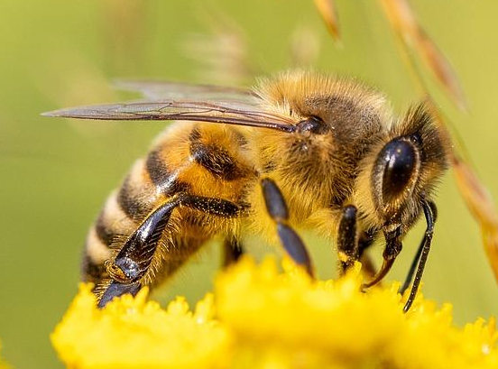
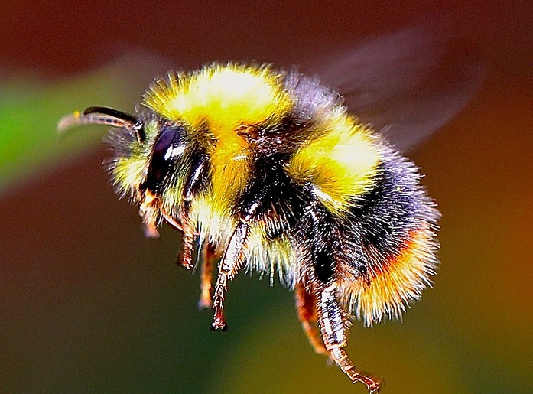
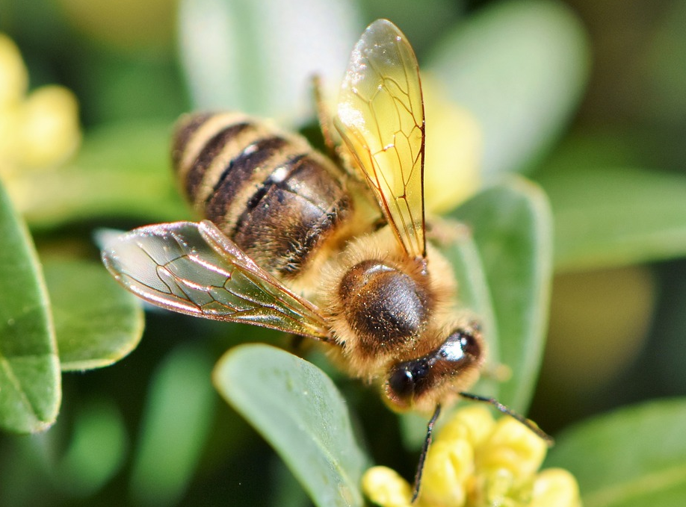
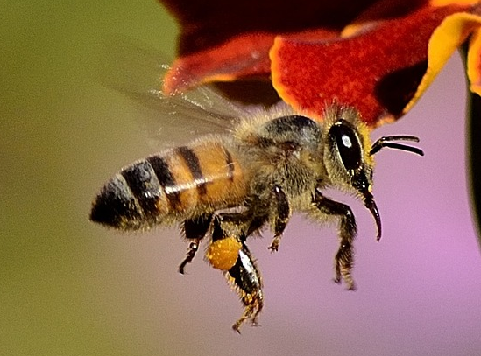
Identifying living things
Alex compares his insect to another type of insect.
Alex’s animal
bees
What similarities does it have with this group of insects?

Slide 33
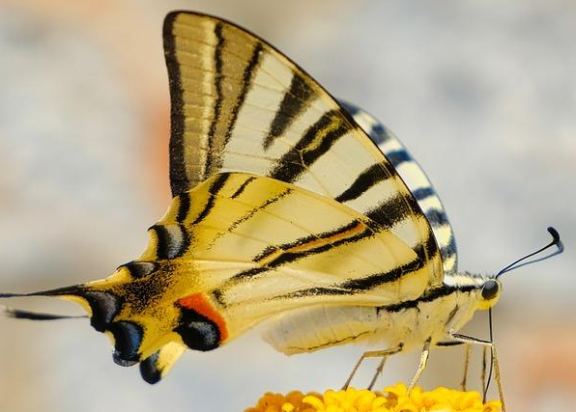
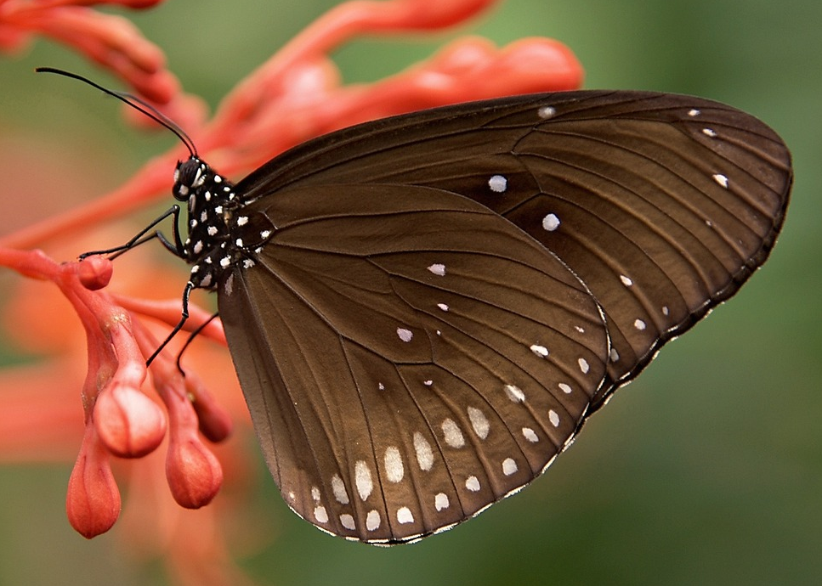
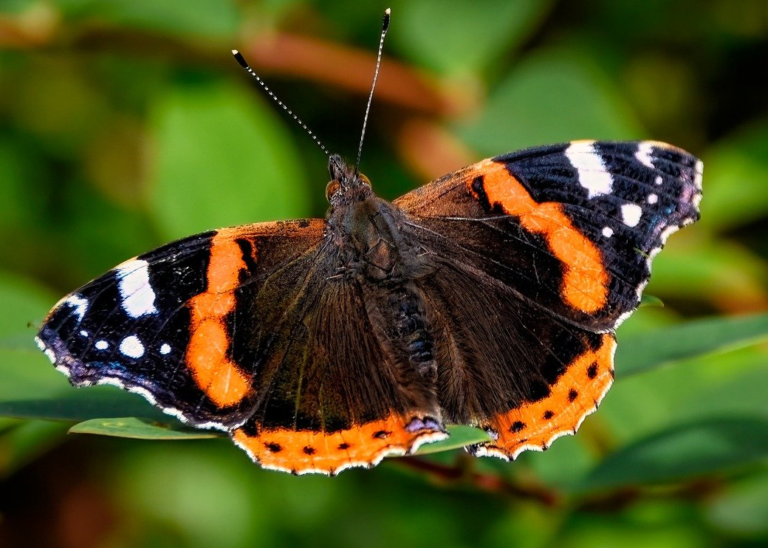
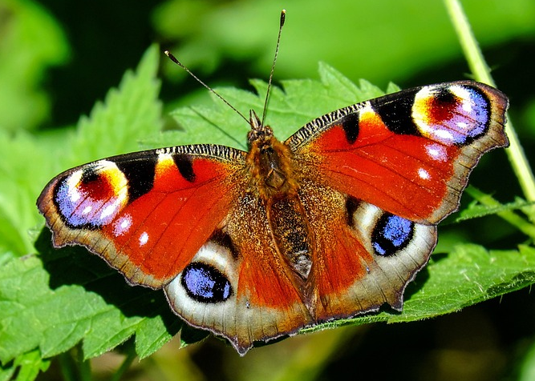
Identifying living things
What similarities does it have with this group of insects?
Alex’s animal
butterflies

Slide 34
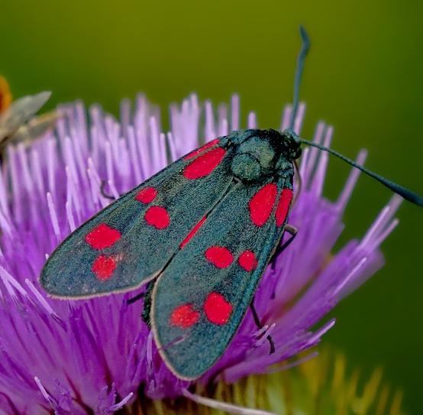
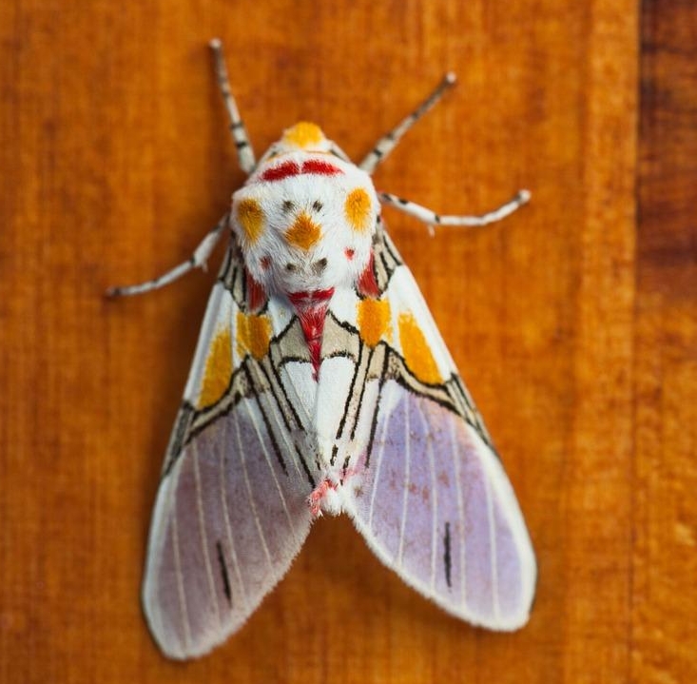
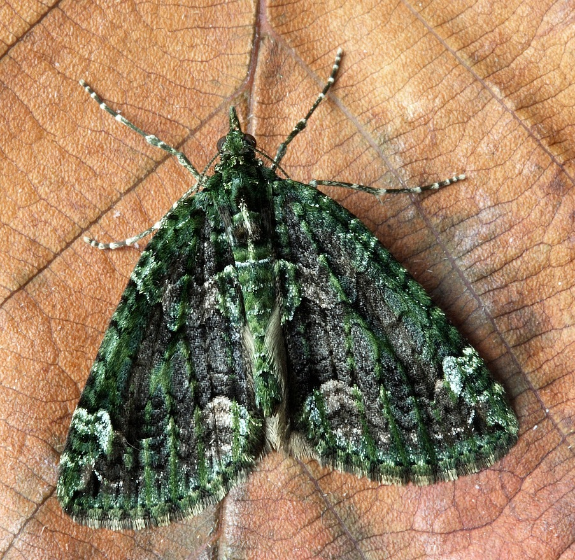
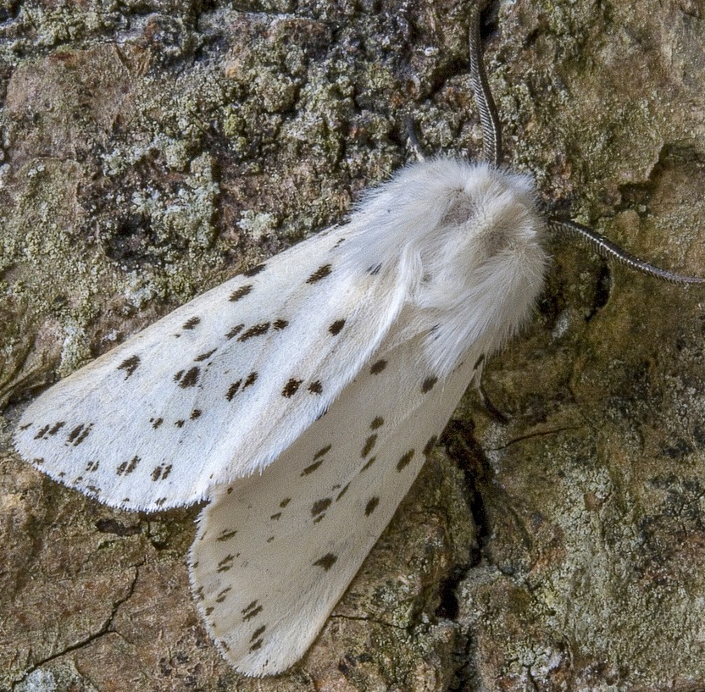
Identifying living things
What similarities does it have with this group of insects?
Alex’s animal
moths

Slide 35
Identifying living things
Which group of insects do you think Alex’s animal has the most in common with?
Alex’s animal
bees
butterflies
moths

Slide 36
Identifying living things
The shape of my insect’s body and wings is most similar to the moths. I think my insect must be a type of moth.
Alex’s animal
moths
Now he knows what kind of insect it is likely to be, Alex can carry out research using secondary sources to identify the type of moth he has found.
Alex

Slide 37

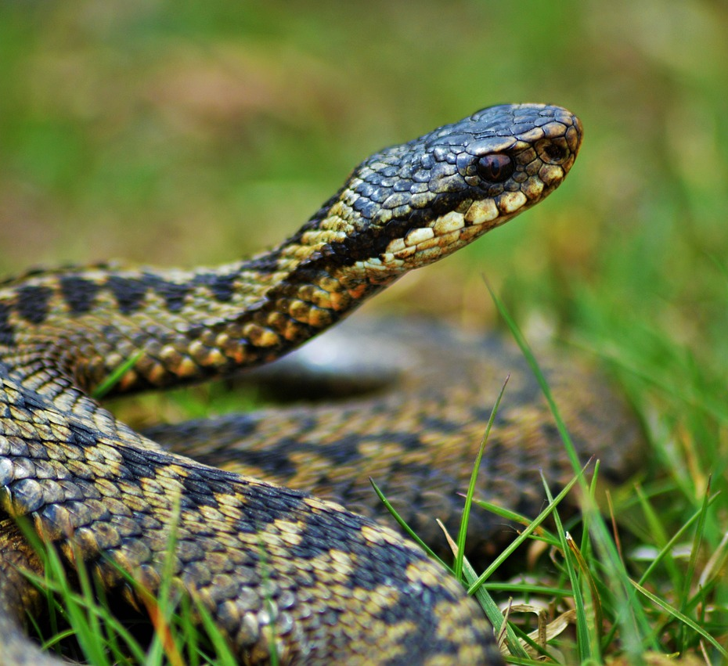
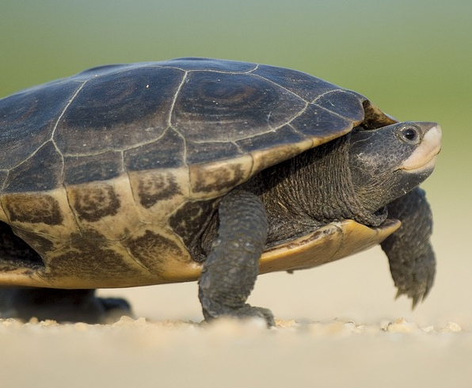
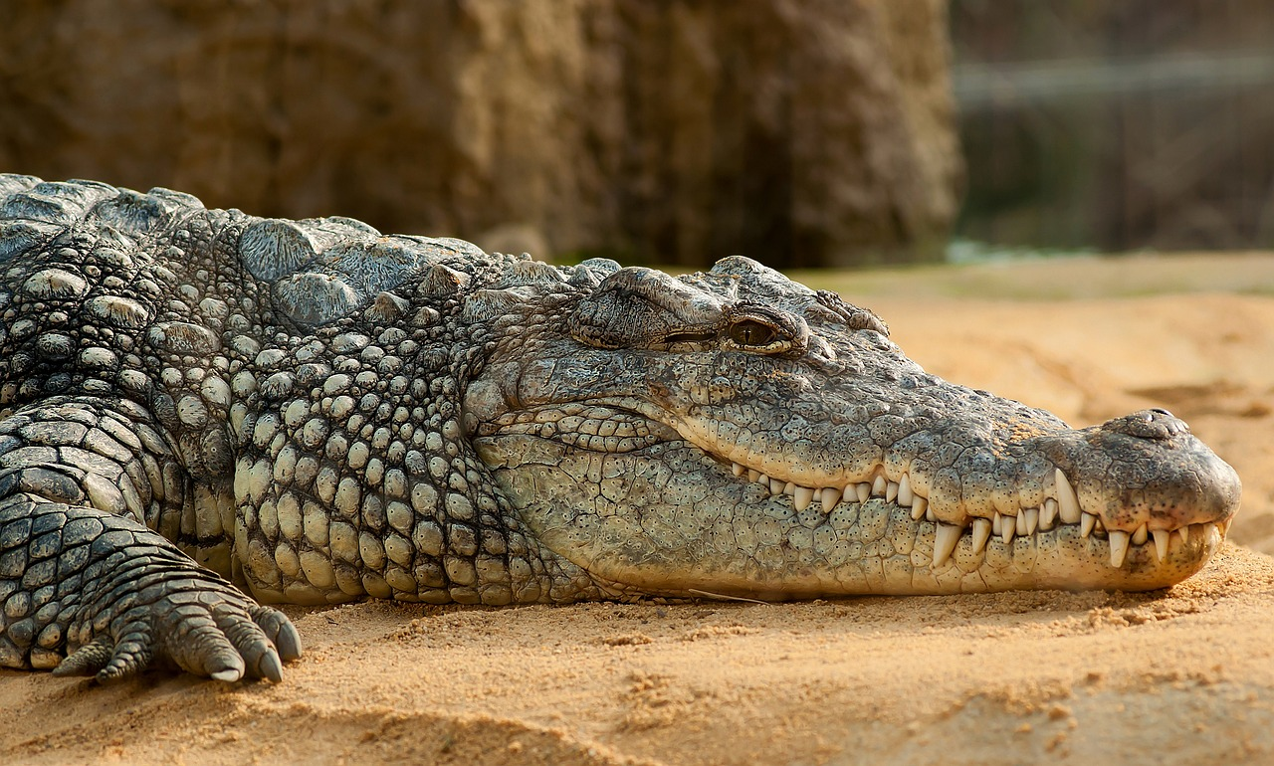
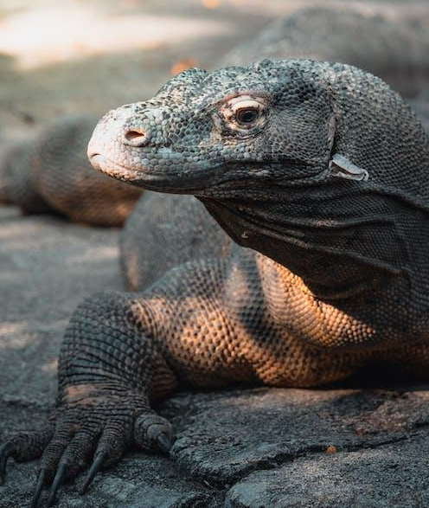
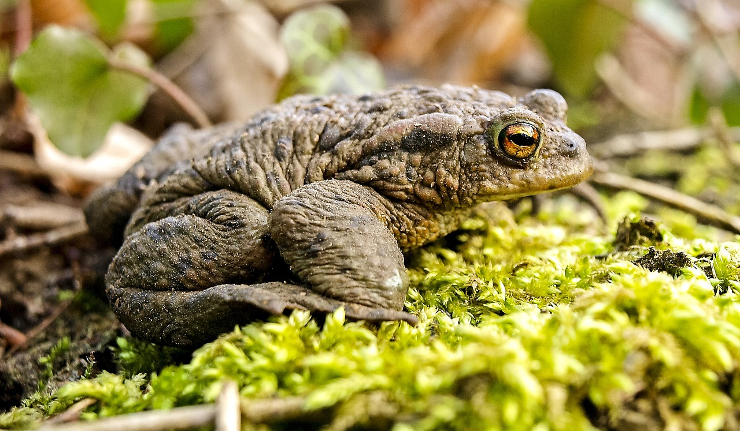


Identifying living things
Which group does this unknown animal have the most similarities with?
a
reptiles
b
unknown animal
amphibians

Slide 38


Identifying living things
Laura has seen a bird in her garden. Help her to identify it by comparing it to different types of birds.
Carefully observe each group of birds and decide which group it belongs to by seeing which it has most observable characteristics in common with.
Explain your reasoning.
Laura’s bird
Laura

Slide 39




Identifying living things
Laura’s bird
pigeons

Slide 40




Identifying living things
Laura’s bird
finches

Slide 41




Identifying living things
Laura’s bird
wagtails

Slide 42
Identifying living things
Carefully observe each group of birds and decide which group it belongs to by seeing which it has most observable characteristics in common with.
I think it is a type of finch because it has a similar body shape. It also has a very similarly shaped beak as the other finches and a short tail made of feathers like the others. The pigeons have longer necks, so it doesn’t look like a pigeon, and I don’t think it belongs in a group with the wagtails because its tail and beak are shorter than theirs.
Laura’s bird
finches
Laura

Slide 43
Comparing characteristics of living things
Observable characteristics are properties about things that we can describe using our five senses.
Living things have many observable characteristics we can use to compare similarities and differences between them.
Comparing and grouping living things can help us to identify them.

