Slide 1
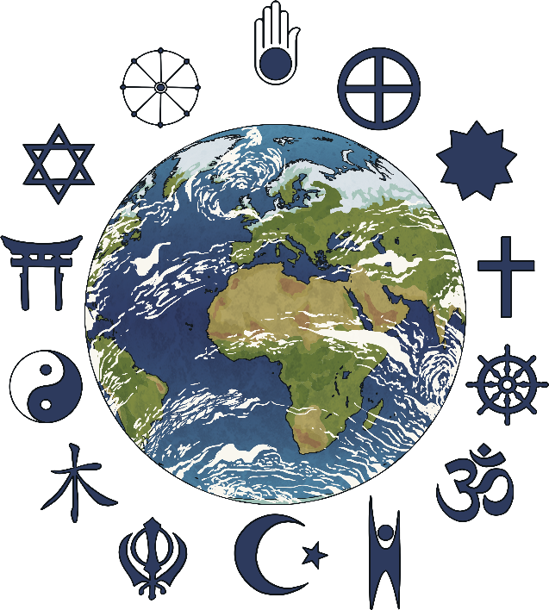
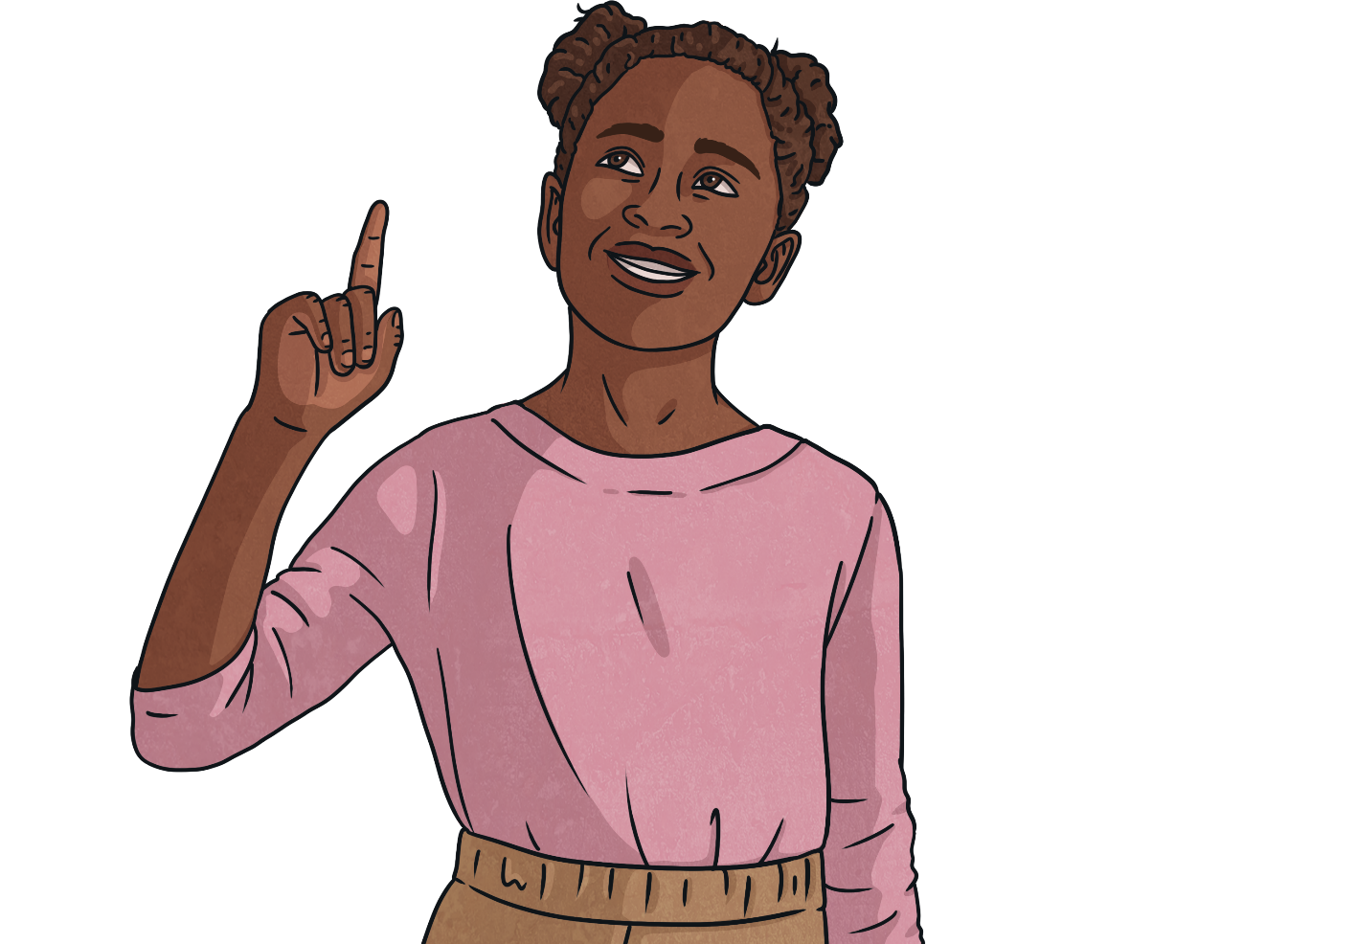
What Happens after Death?
Most worldviews have certain beliefs about what happens after death.
There are similarities and differences within these beliefs.

Slide 2
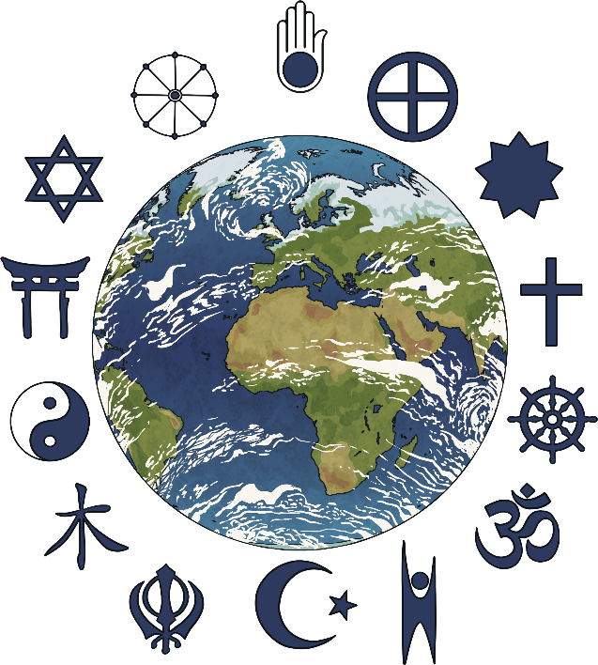

Beliefs
Some worldviews believe in the idea of an afterlife. They believe that after death, people go to one place or the other.
Humanists believe that there is no life after death.
Other faiths believe in reincarnation.

Slide 3
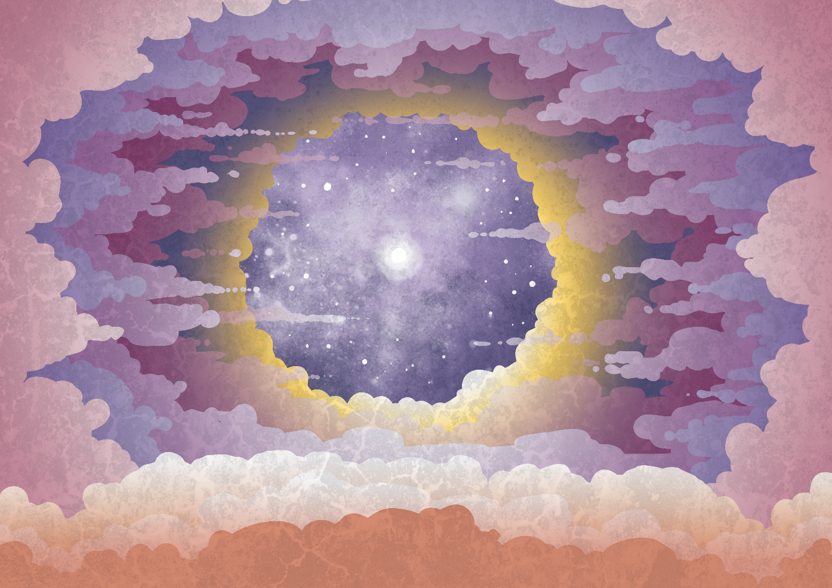





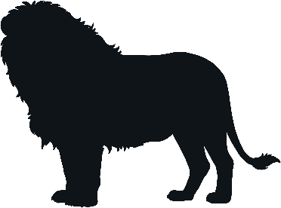
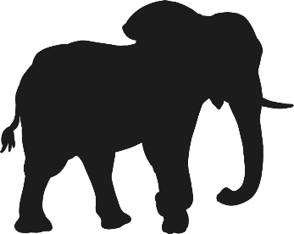
Reincarnation
Reincarnation is the idea that after death, a soul can be reborn (or reincarnated) in another form. This cycle is believed to be an ongoing process which carries on over thousands of lifetimes.

Slide 4
The Cycle of Samsara
birth/rebirth
For most Hindus, life is seen as a cycle of birth, life, death and rebirth. In both Hindu Dharma and this is known as the cycle of samsara.
Samsara
life
death

Slide 5
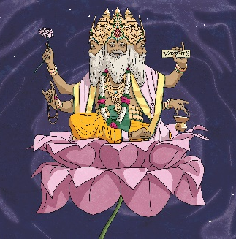
Samsara in Hindu Dharma
According to Hindu tradition, all living things contain an atman (a spirit or soul which is a part of Brahman and can never be destroyed). It is the atman (the soul) which enters a new form in the next life.
birth/rebirth
Moksha
Samsara
With each reincarnation, the soul (atman) moves closer to God. The cycle of samsara ends when a soul finally reaches moksha: freedom from the continual cycle of death and rebirth, and finally being at one with God. Reaching moksha is the ultimate goal for Hindus.
death
life
‘As a man casts off worn-out garments and puts on new ones, so the… soul casts off the worn-out body and enters… new ones.’ - Bhagavad Gita

Slide 6
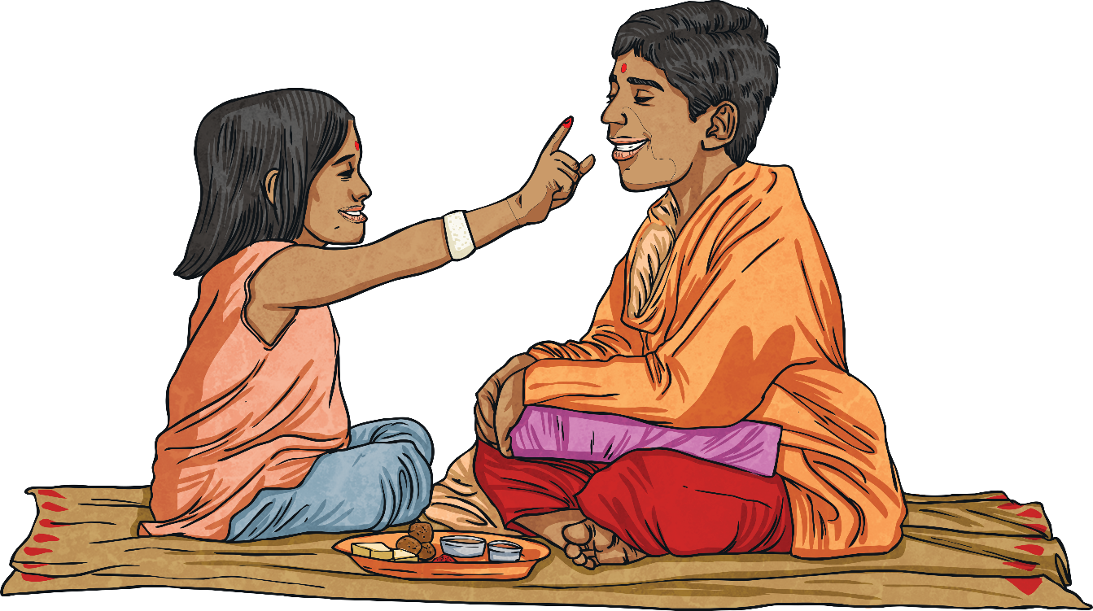
Karma
Hindus believe that the decisions and actions they make in this life effect what form they will take in the next life. This cause and effect is known as karma. If a person makes good choices, they will have good karma. Having good karma means they will be reincarnated into something better than they were in their previous life. Hindus believe
that they can earn good karma by doing the right thing and living out their duties
(known as dharma).

Slide 7
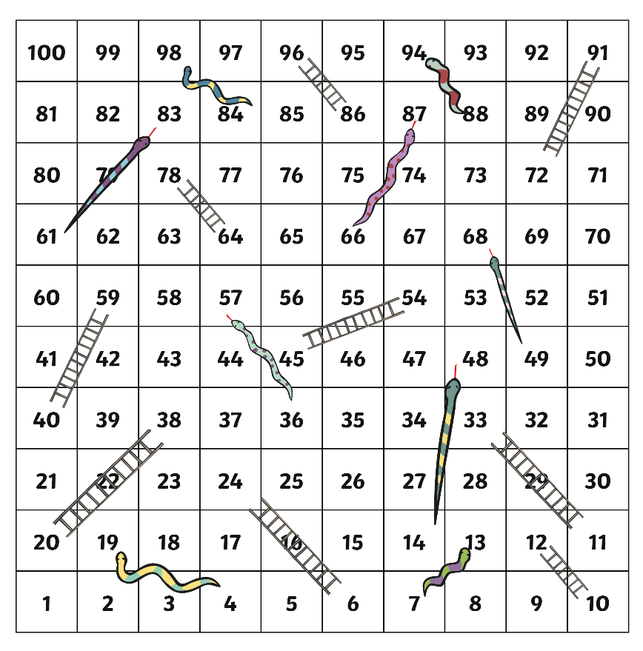
Mokshapat (Snakes and Ladders)
The game of snakes and ladders (known in ancient India as Mokshapat or Moksha Patamu) is thought to have stemmed from Hindu beliefs about life and the cycle of samsara.
The ladders are believed to symbolise good karma earned by performing acts of kindness, faith and humility. Whereas, the snakes are thought to represent the bad karma caused by wrongful acts, such as murder or theft. Once the player has completed the game, they are free of the cycle, symbolic of reaching moksha.

Slide 8
Mokshapat (Snakes and Ladders)
The game carried a moral message: that moksha is earned through righteous deeds, while evil deeds lead to rebirth in lower forms of life. This was echoed in the imagery that often adorned the boards. The top was often decorated with gods, angels and other majestic beings, while the bottom featured humans, animals and flowers.
In the original Hindu game, snakes outnumbered ladders, signifying that a moral path is more difficult to follow than a life of bad deeds.

Slide 9
What Are Your Views?
What do you believe about good and bad actions?
Do you believe that good actions lead to good consequences?
Do you believe that all animals have good and bad behaviour?
What do you believe about why bad things happen?
What do you believe a soul is?
What do you believe about life after death?
What do you believe about the cycle of samsara?

