Slide 1
Monday 19th October
LC: To explain how animals can be grouped using observable characteristics.

Slide 2
classify
identify
vertebrate
invertebrate
classification key

Slide 3
To classify is to sort into groups.
To identify something is to be able to name it correctly.
A vertebrate is an animal with an internal skeleton, including a spine.
Animals that do not have bones, including a spine, on the inside of their bodies are invertebrates.
Classification keys are diagrams which help us sort things into different groups.

Slide 4

How and why we group animals
Vertebrates and invertebrates
Groups within vertebrates and invertebrates
Creating classification keys

Slide 5
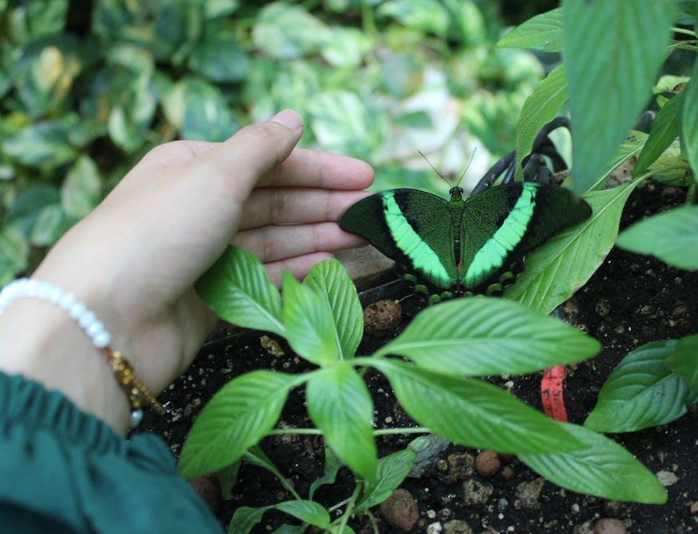
Vertebrates and invertebrates
There are millions of species of animals living on planet Earth and scientists are discovering new ones all the time.
Scientists classify, or group, animals to make it easier to identify, name and learn more about them.
Scientists who specialise in identifying and classifying animals are called taxonomists.
taxonomist observing an animal

Slide 6


Vertebrates and invertebrates
When a new animal is discovered, taxonomists look at the similarities and differences between it and other animals to decide which group it belongs in.
Do you know any names of the groups taxonomists use for different animals?
?
Andeep

Slide 7
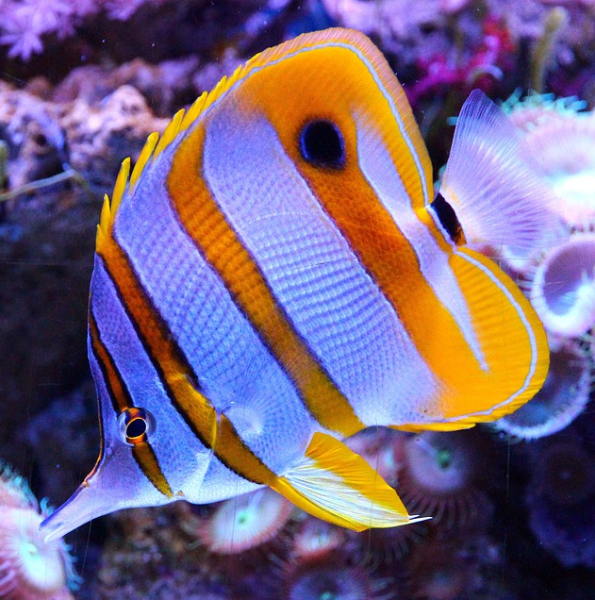
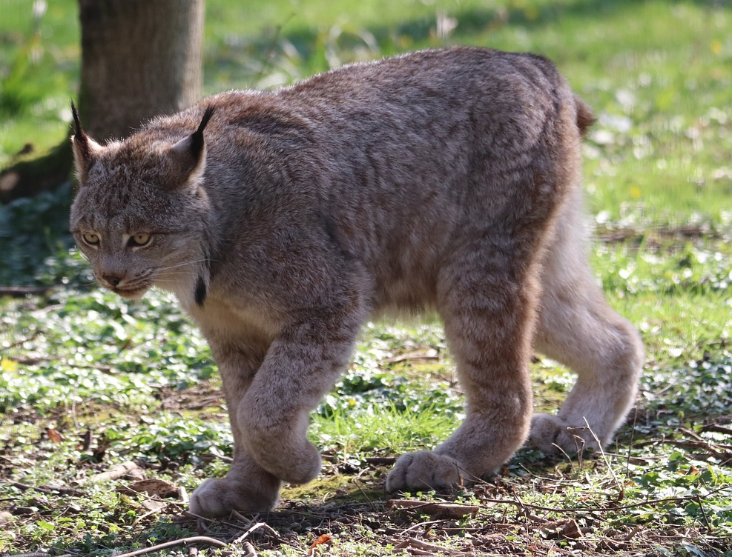
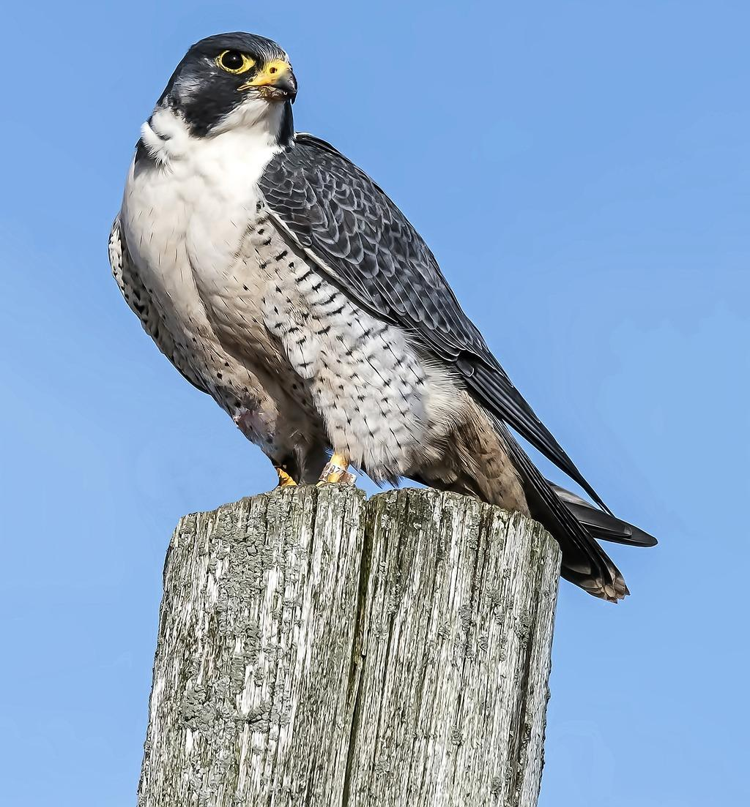
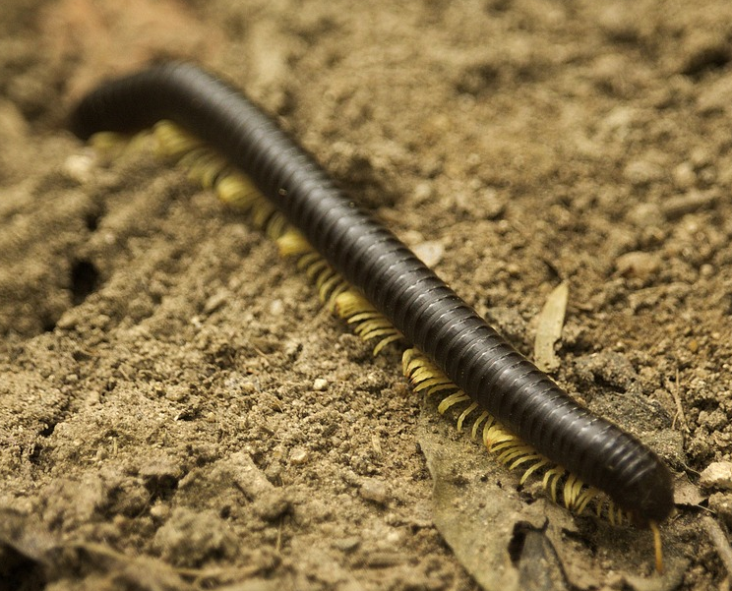
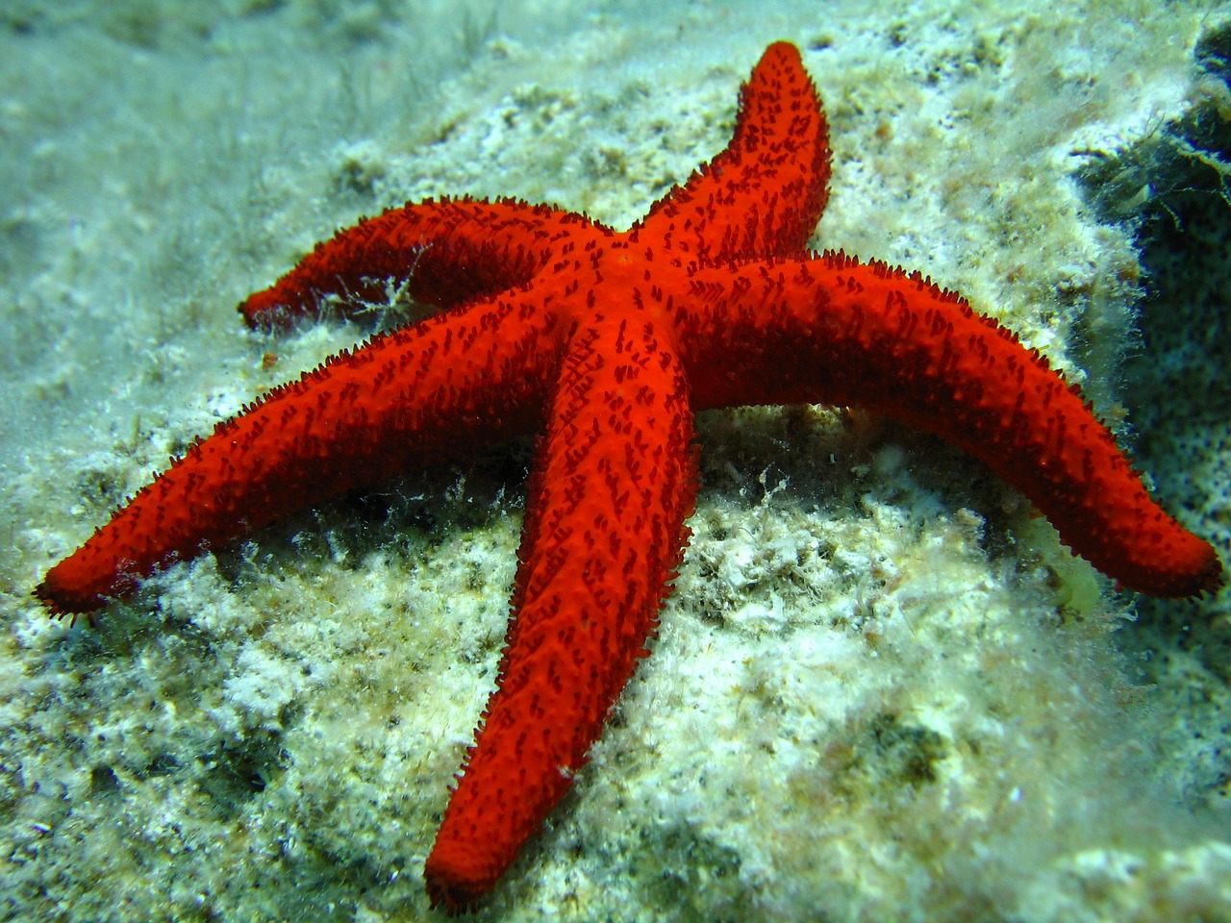
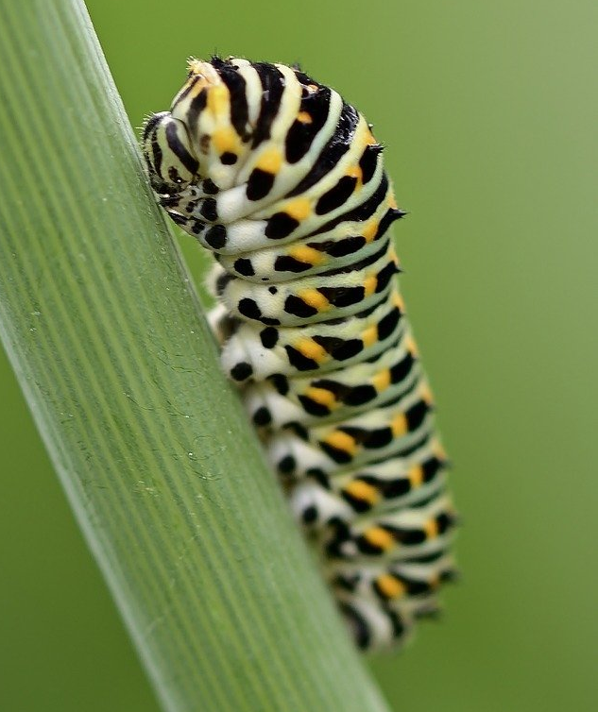
Vertebrates and invertebrates
One way taxonomists can classify animals is by sorting them into vertebrates and invertebrates.
Vertebrates are animals that have a spine (or backbone) and an internal skeleton.
Invertebrates do not have a spine or internal skeleton.
vertebrates
invertebrates

Slide 8


Vertebrates and invertebrates
Which of these animals are invertebrates?
a
human
b
shark
c
caterpillar
d
worm
e
crocodile

Slide 9


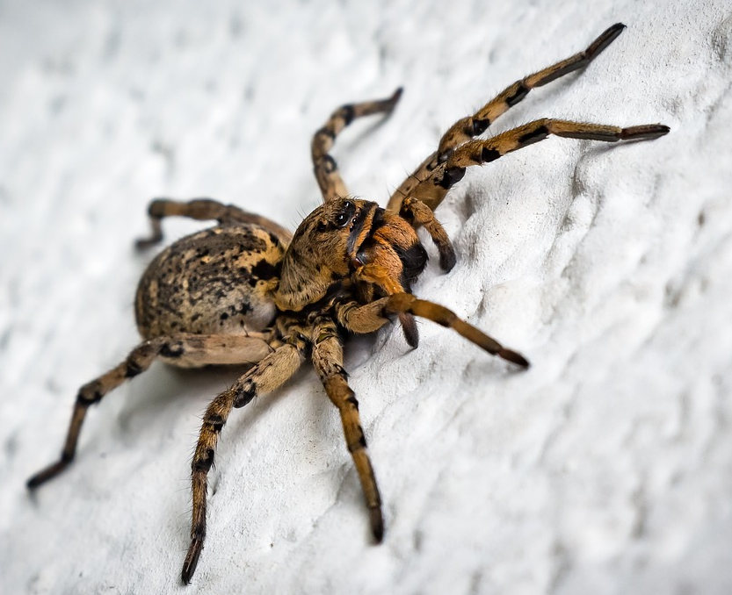
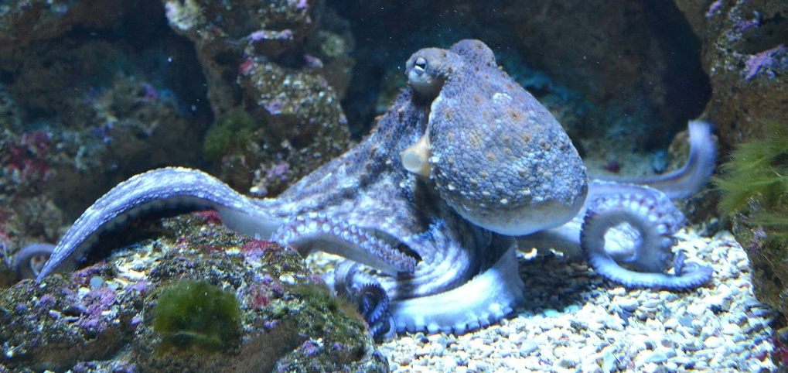
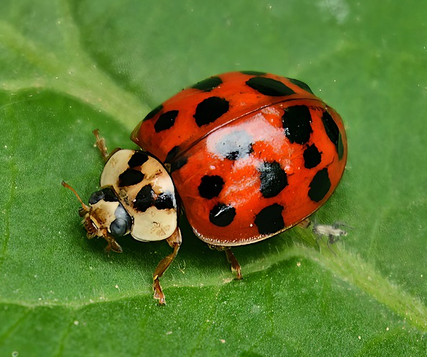
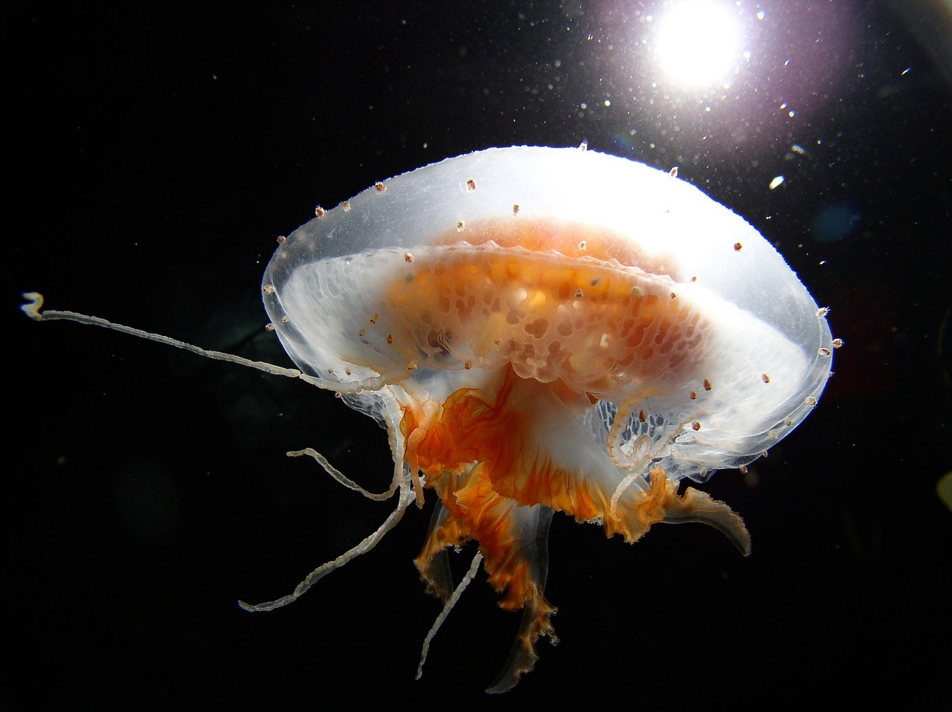
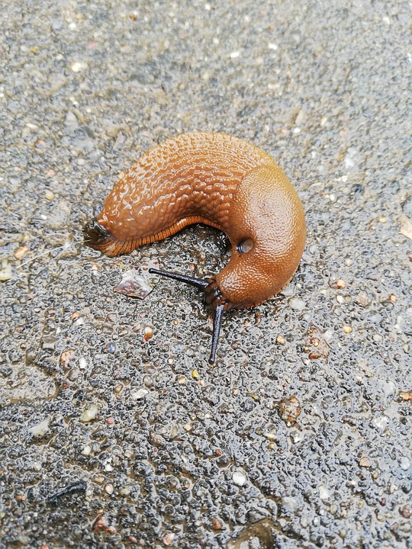
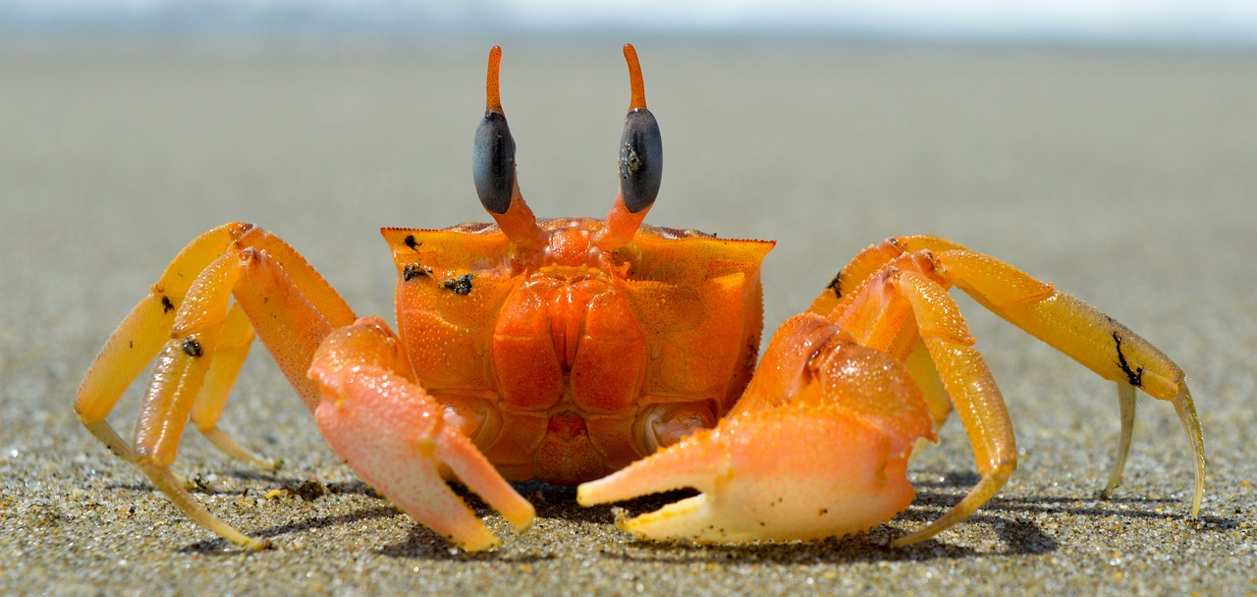
Vertebrates and invertebrates
If invertebrates don’t have skeletons, how are their bodies supported and their organs protected?
Jun
invertebrates

Slide 10
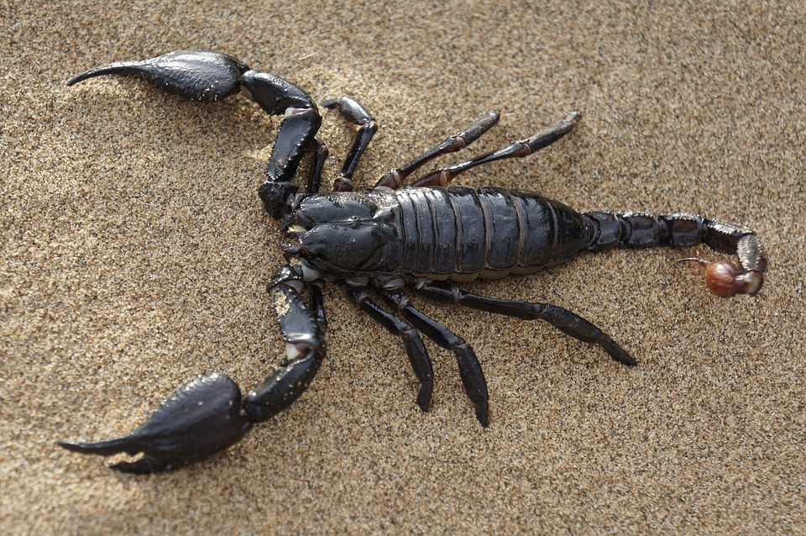
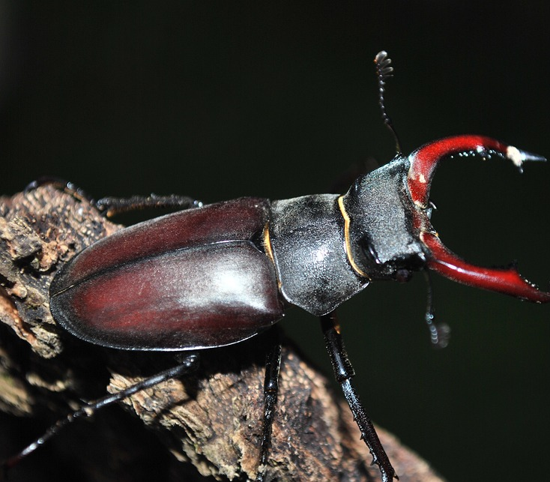
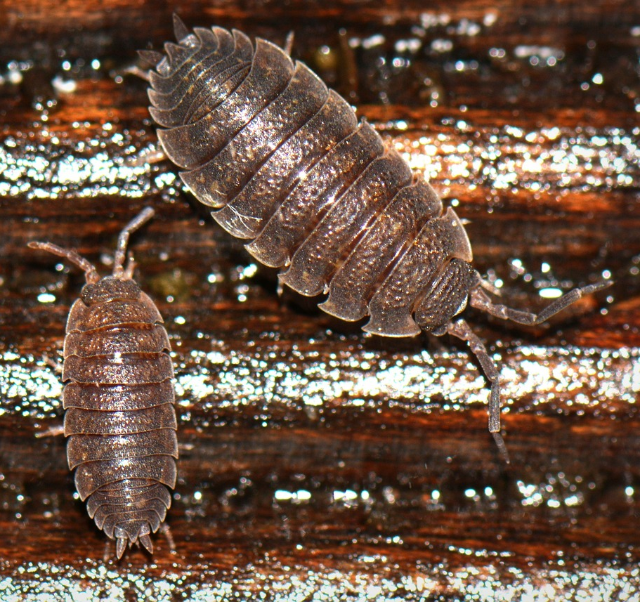
Vertebrates and invertebrates
Some invertebrates have a hard outer covering that protects their body.
This is called an exoskeleton.
As the animal grows, they moult their exoskeleton, and their fresh outer layer hardens to form a new, larger exoskeleton.
invertebrates with exoskeletons

Slide 11
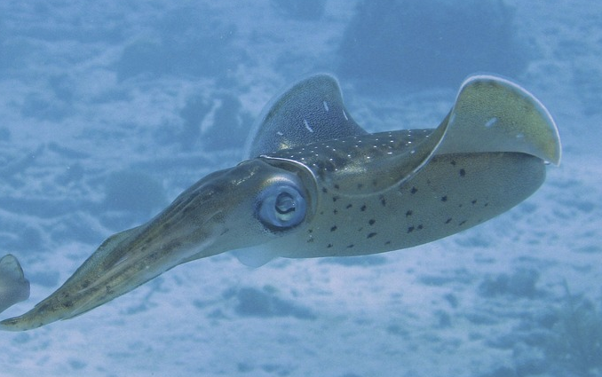
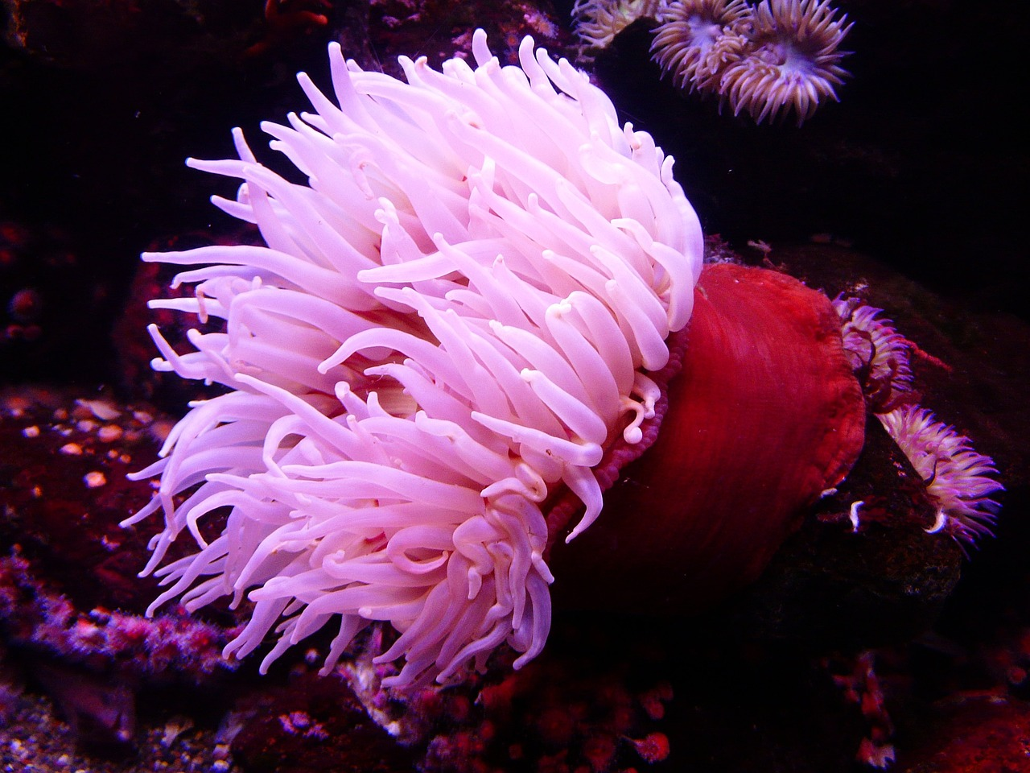
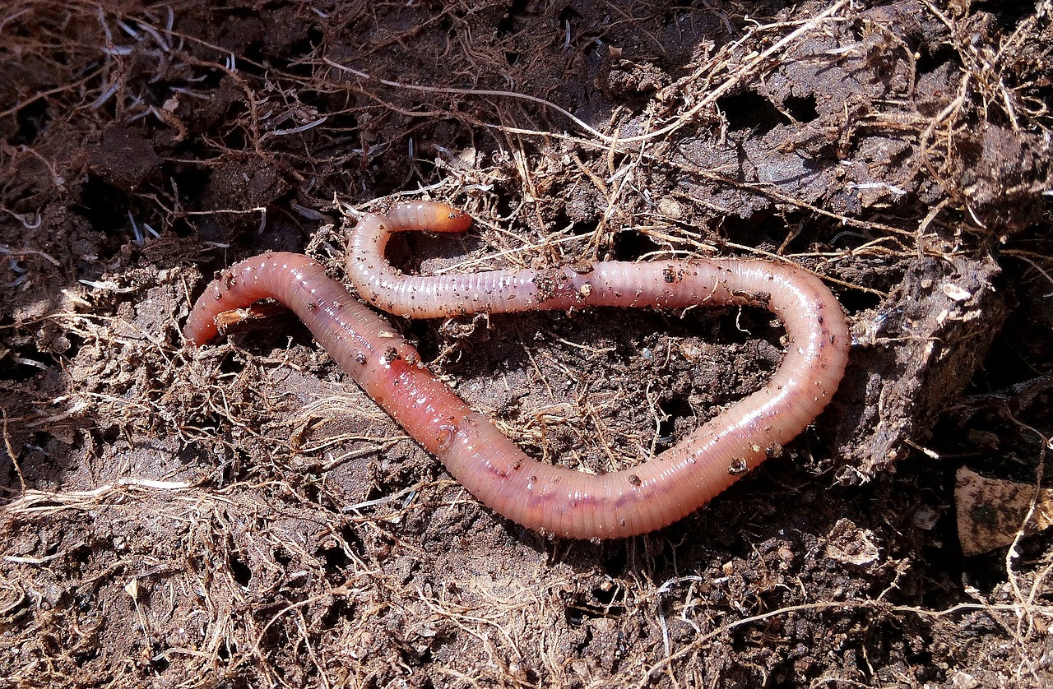
Vertebrates and invertebrates
Some invertebrates have a body filled with fluid that supports their body and helps them to move.
This is called a hydrostatic skeleton.
invertebrates with hydrostatic skeletons

Slide 12
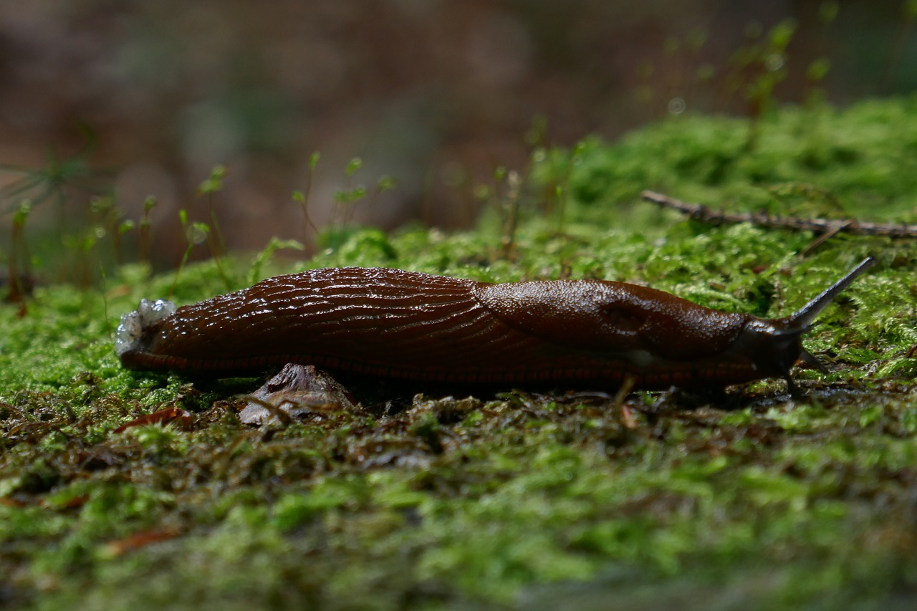
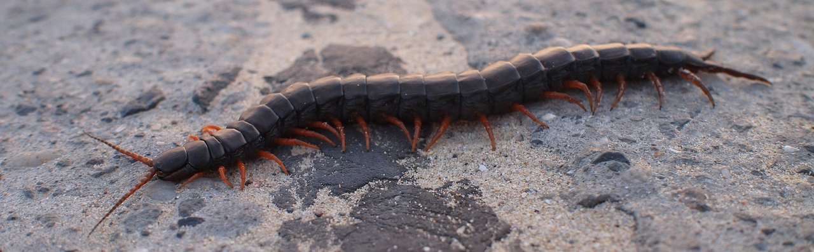
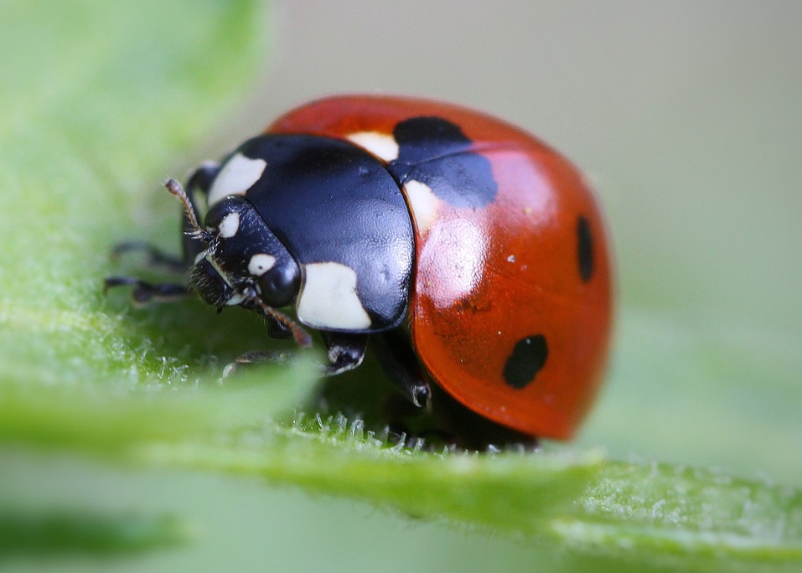
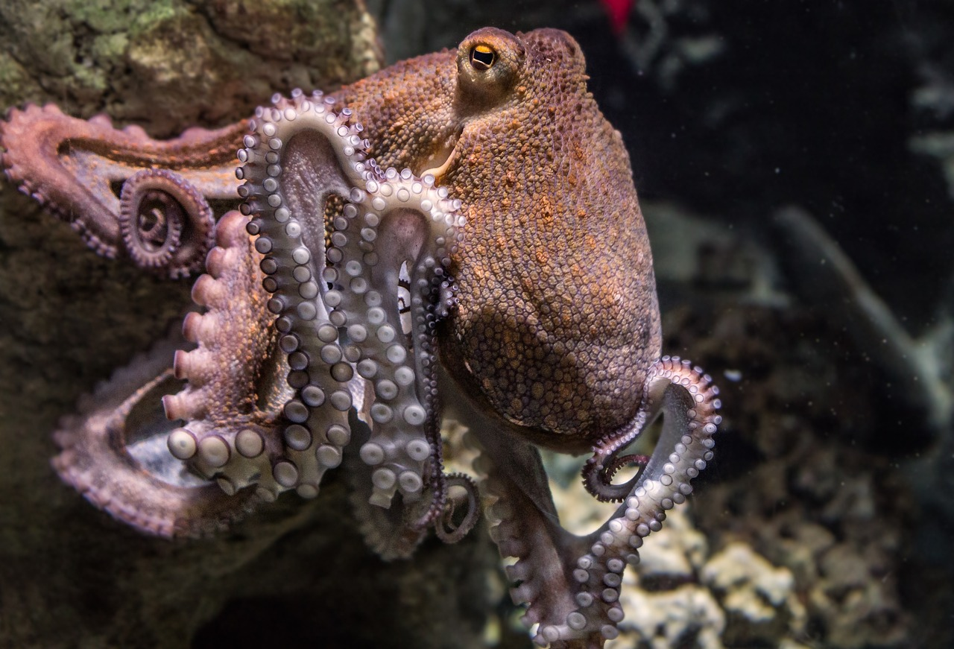
Vertebrates and invertebrates
Which of these invertebrates have hydrostatic skeletons?
a
b
slug
millipede
c
d
ladybird
octopus

Slide 13
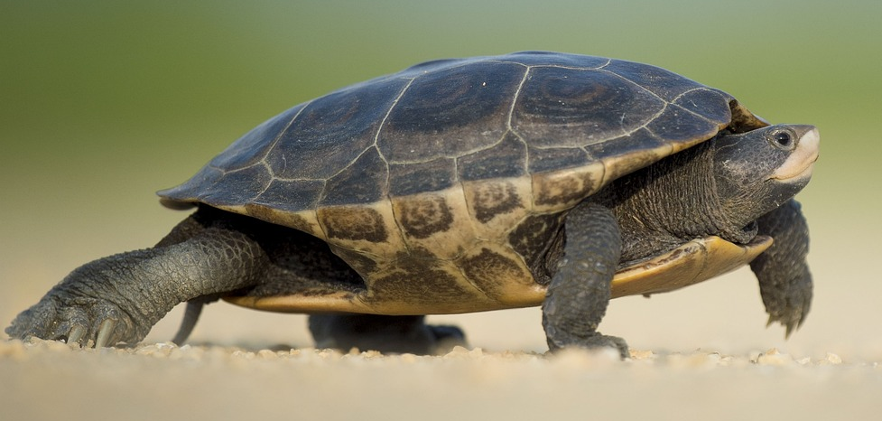

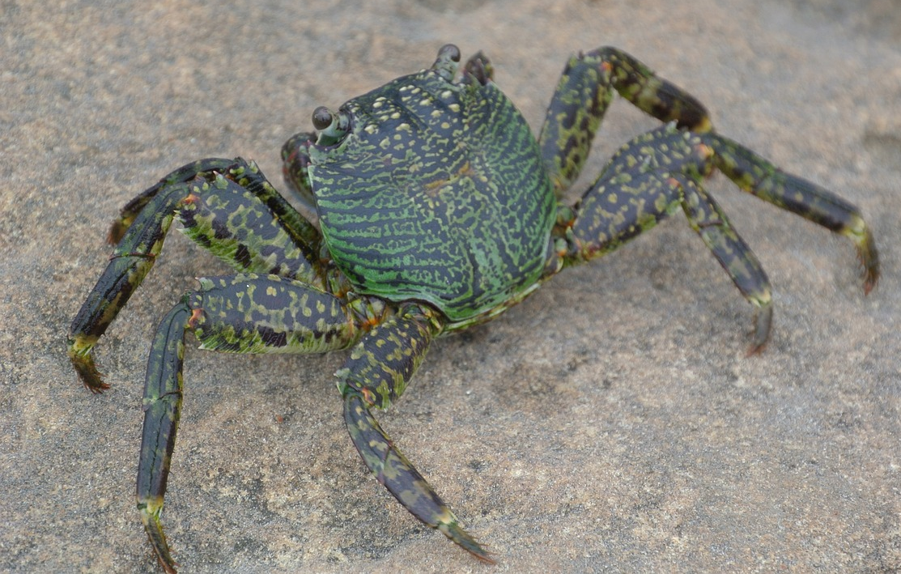

Vertebrates and invertebrates
Some animals can be difficult to classify into the vertebrate or invertebrate group because of the way they look.
These animals both have hard shells on their backs. I think they are both invertebrates with exoskeletons.
tortoise
Izzy
The tortoise is a reptile, which is a vertebrate, so I think the crab is too. Its hard shell is its backbone.
crab
Jacob
What do you think?

Slide 14
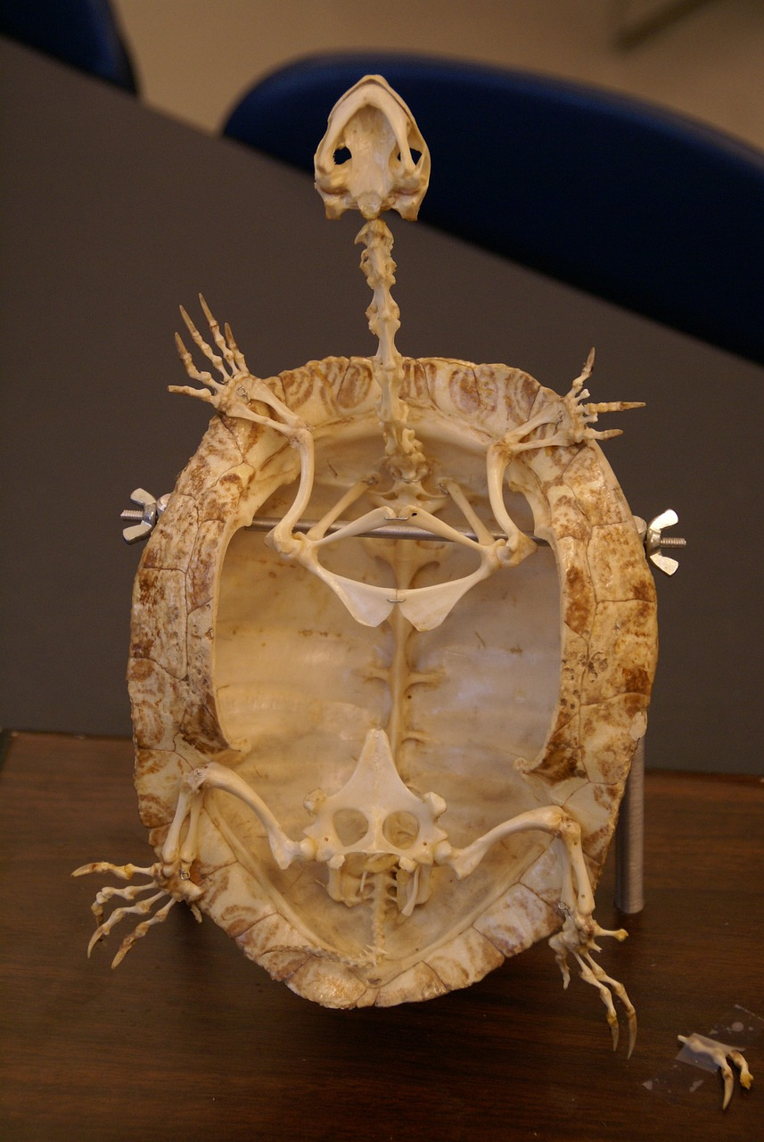
Vertebrates and invertebrates
The crab’s shell is part of its exoskeleton. It has no internal skeleton. It is an invertebrate.
The tortoise is a reptile. It has a spine and an internal skeleton, so it is a vertebrate.
tortoise
crab
tortoise skeleton

Slide 15
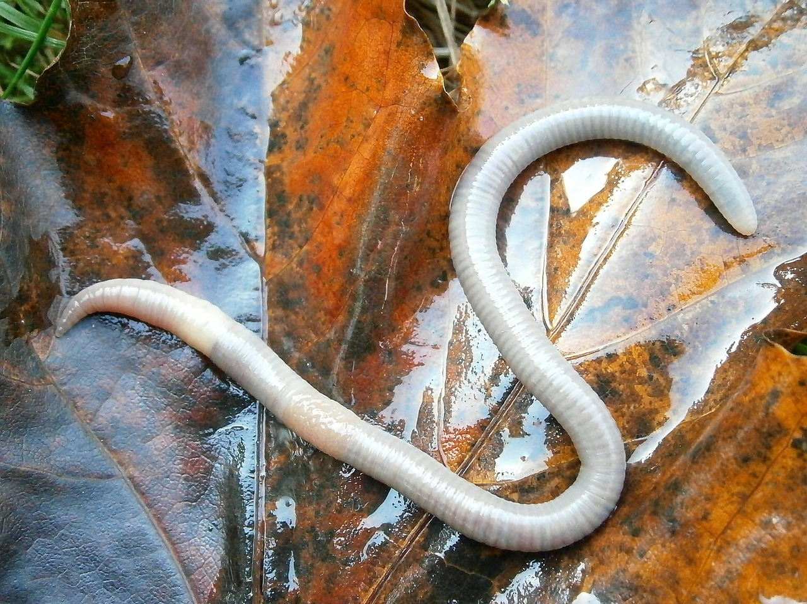

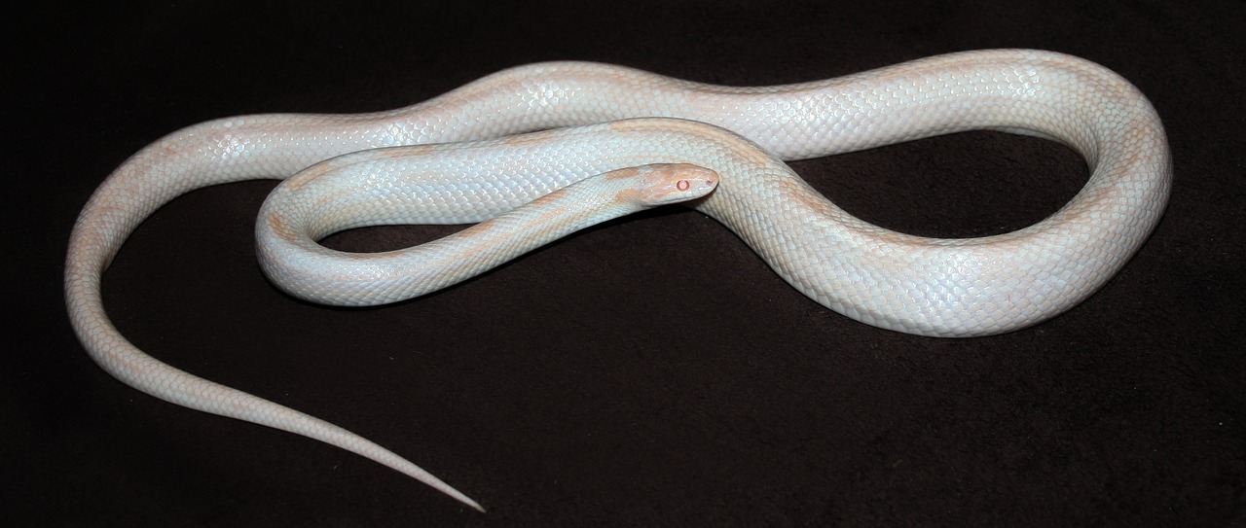

Vertebrates and invertebrates
These animals are both very bendy and neither of them has arms or legs. I think they both have bodies filled with fluid rather than an internal skeleton.
earthworm
Aisha
I know the snake is a reptile so it must be a vertebrate. I think they are both vertebrates.
snake
Laura
What do you think?

Slide 16
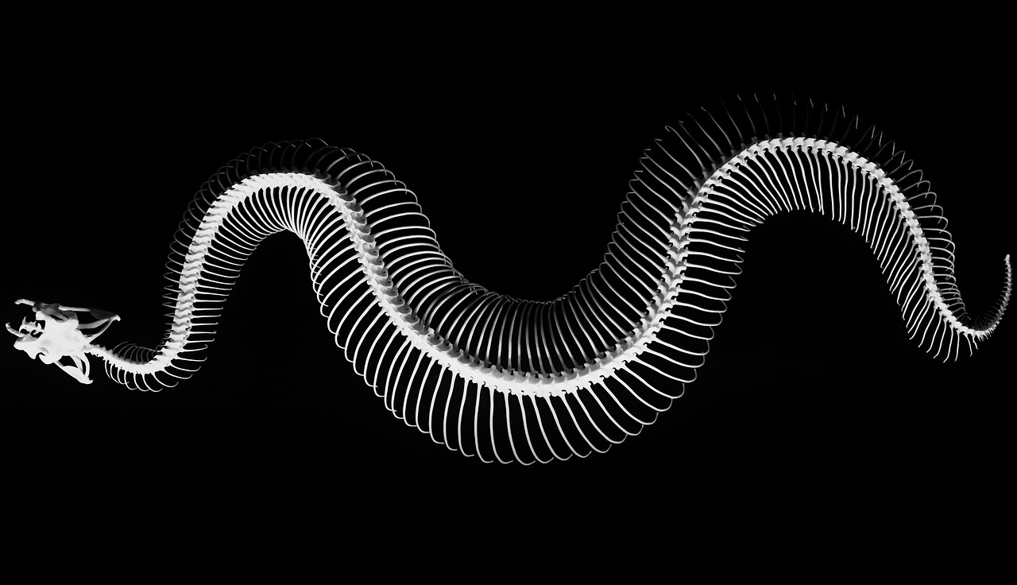
Vertebrates and invertebrates
The snake is a reptile. It has a spine and an internal skeleton, so it is a vertebrate.
The earthworm has no internal skeleton, so it is an invertebrate.
snake skeleton
earthworm

Slide 17
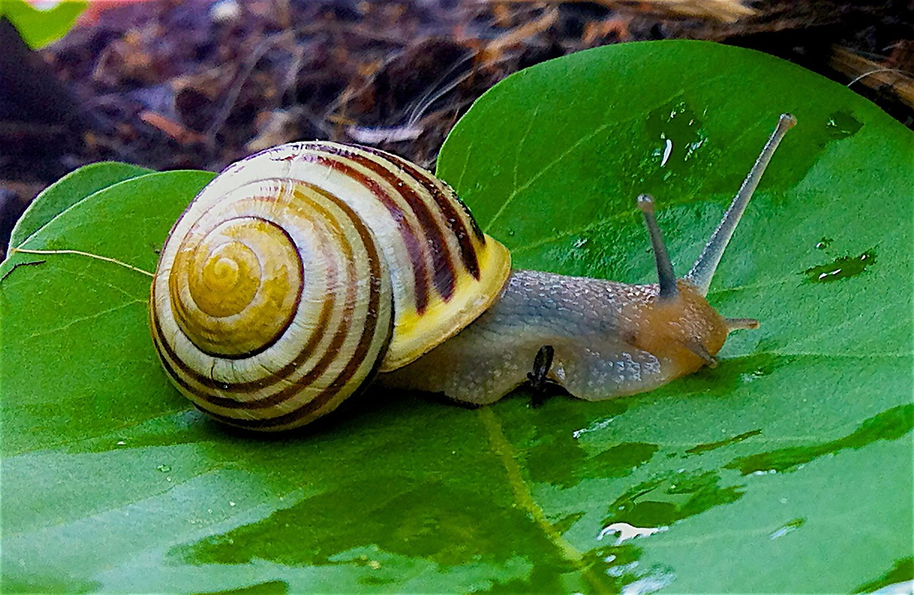
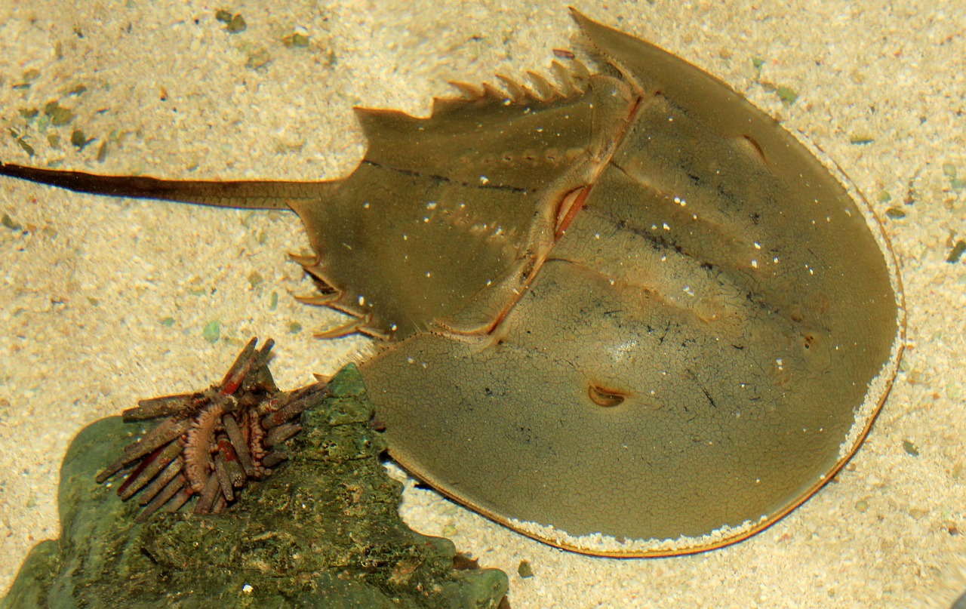
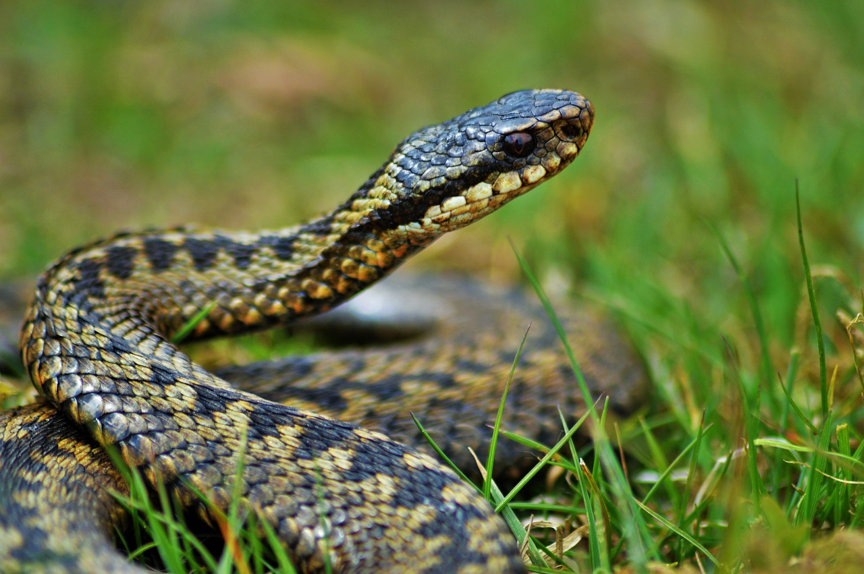
Vertebrates and invertebrates
Which of these animals are vertebrates?
garden snail
horseshoe crab
adder

Slide 18

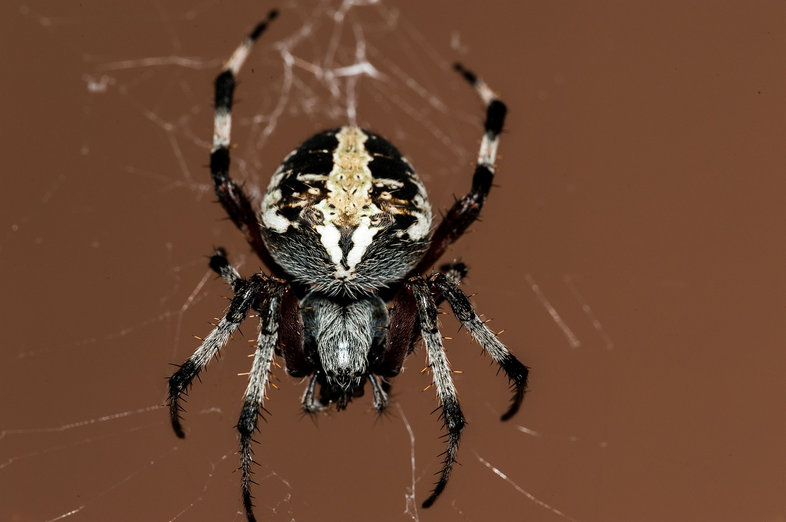
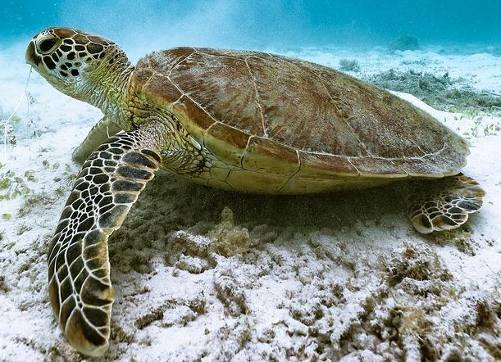
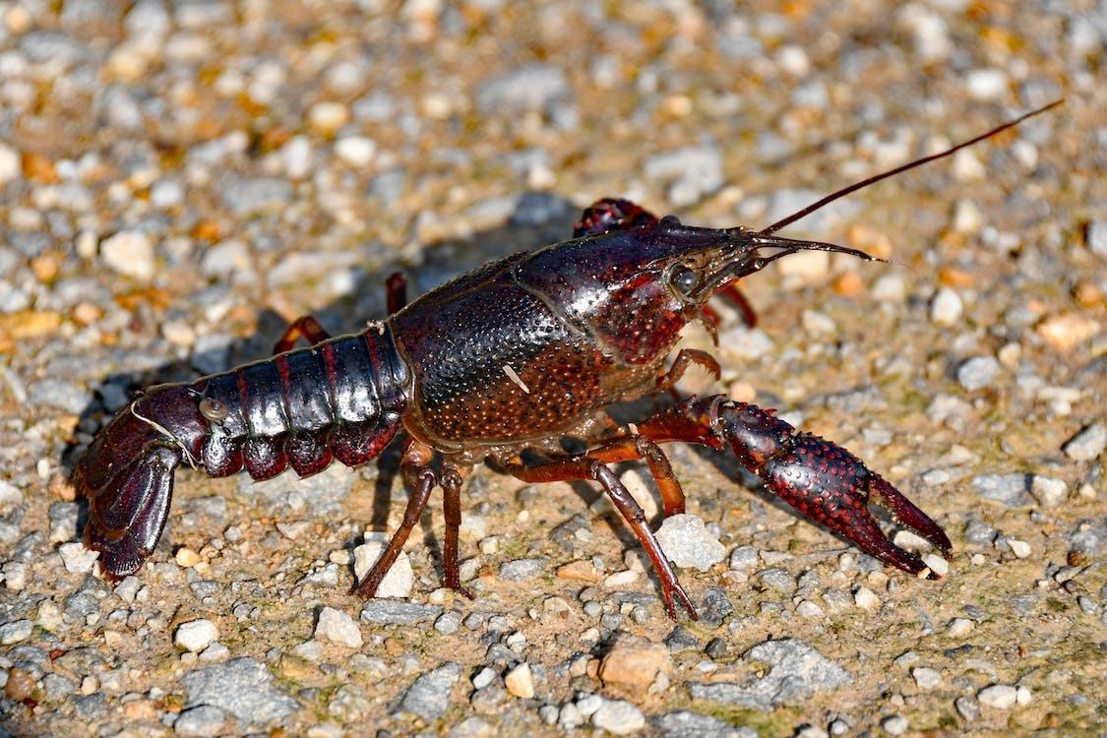
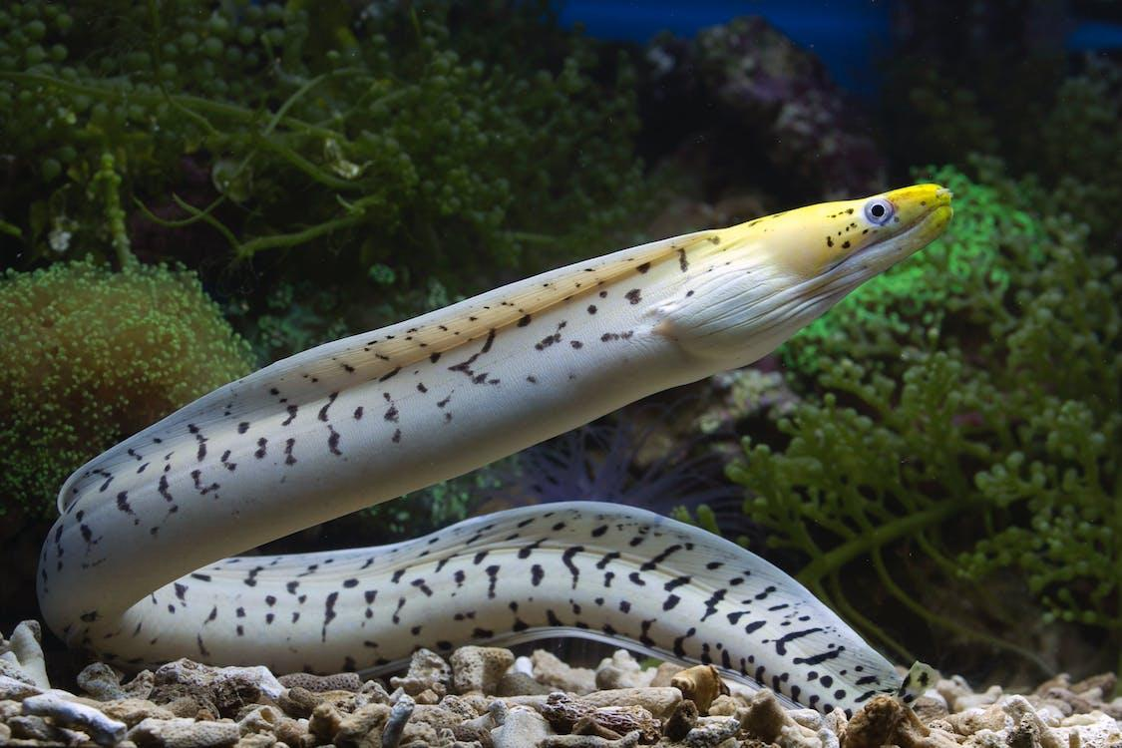
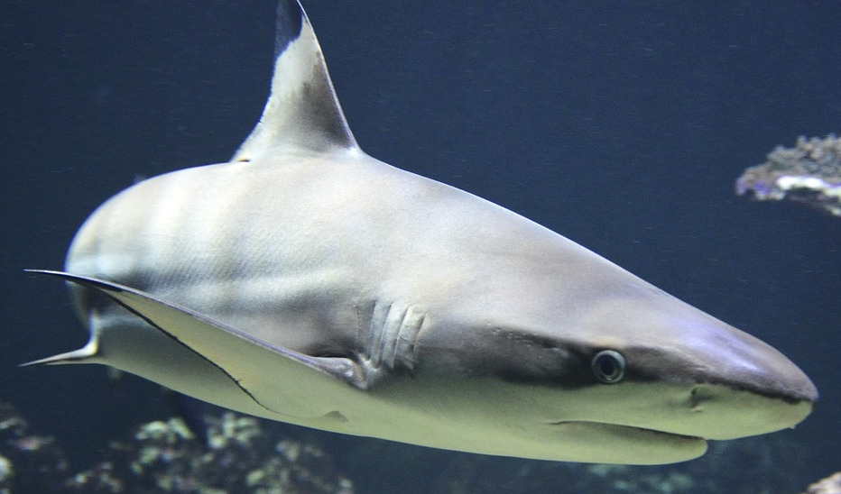
Vertebrates and invertebrates
Sam has classified some animals into vertebrates and invertebrates, but she has made some mistakes.
Spot her mistakes.
Explain why she might have made each mistake.
Sam
vertebrates
invertebrates
lobster
eel
spider
turtle
worm
shark

Slide 19
Vertebrates and invertebrates
Spot Sam’s mistakes.
Explain why she might have made each mistake.
The lobster should be with the invertebrates because it has no spine or internal skeleton. Sam might have thought its hard covering is a backbone, but it is an exoskeleton.
lobster
The eel should be with the vertebrates because it is a fish, so is a vertebrate with a spine. Sam might have thought it was an invertebrate because it is very bendy and flexible like a worm.
eel

Slide 20
How and why we group animals
Vertebrates and invertebrates
Groups within vertebrates and invertebrates
Creating classification keys

Slide 21

Groups within vertebrates and invertebrates
Vertebrate animals can be further divided into groups.
Can you remember any of the vertebrate groups?
?
Lucas

Slide 22
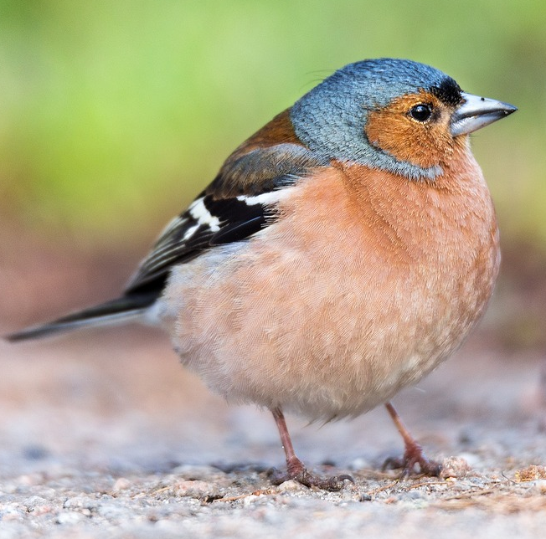
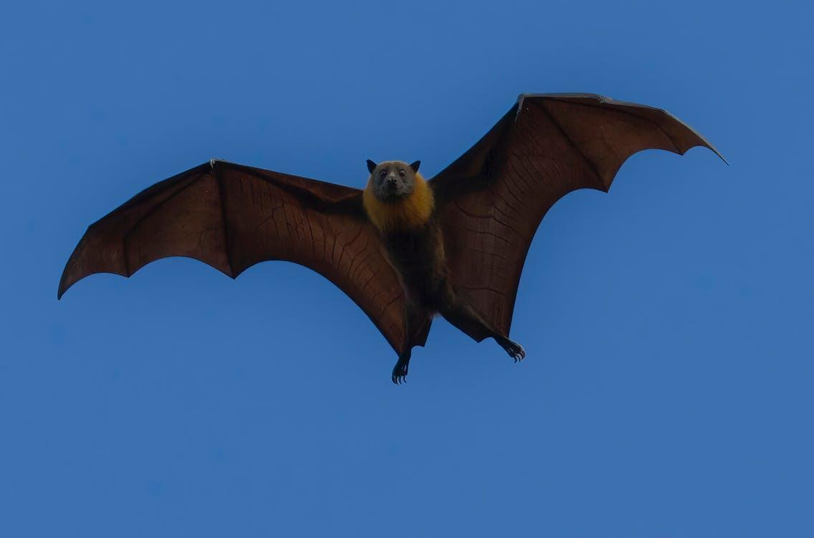
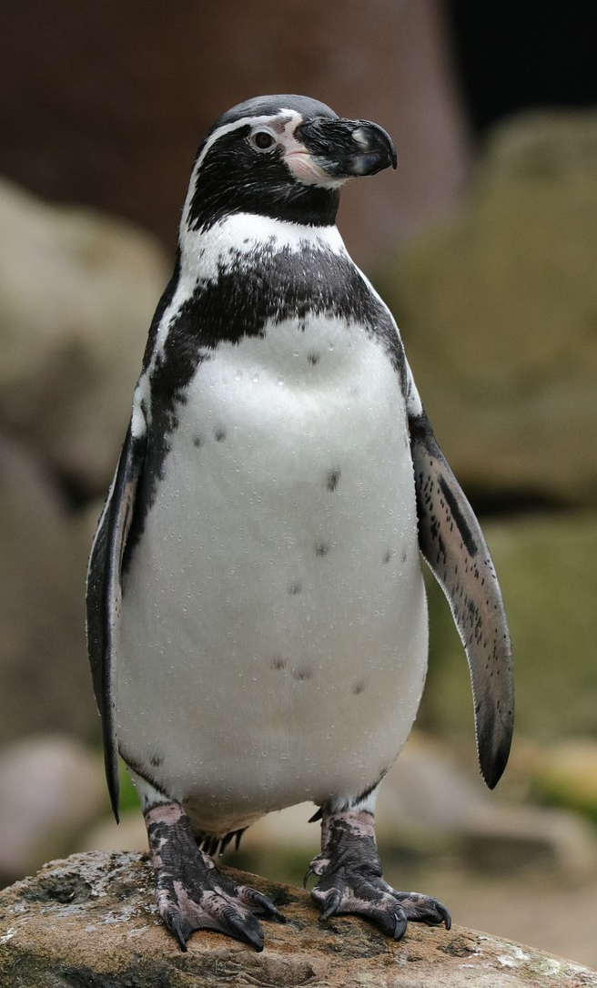
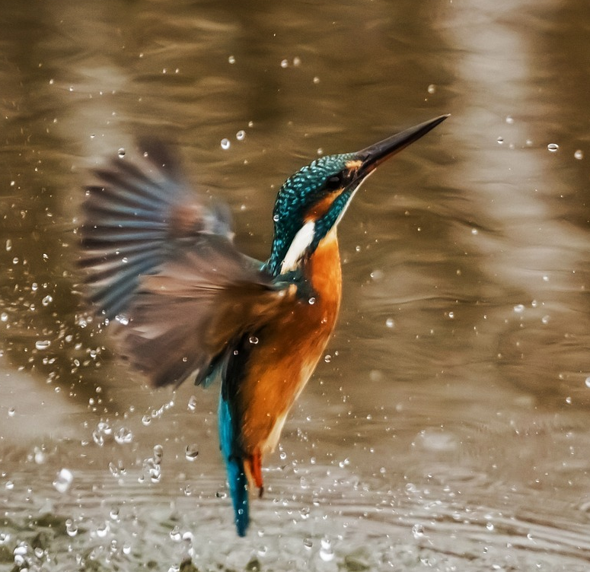
Groups within vertebrates and invertebrates
All of these animals belong to the same group except one. Can you spot which one?
chaffinch
bat
penguin
kingfisher
The bat doesn’t belong in this group.
The rest of these animals are birds.

Slide 23
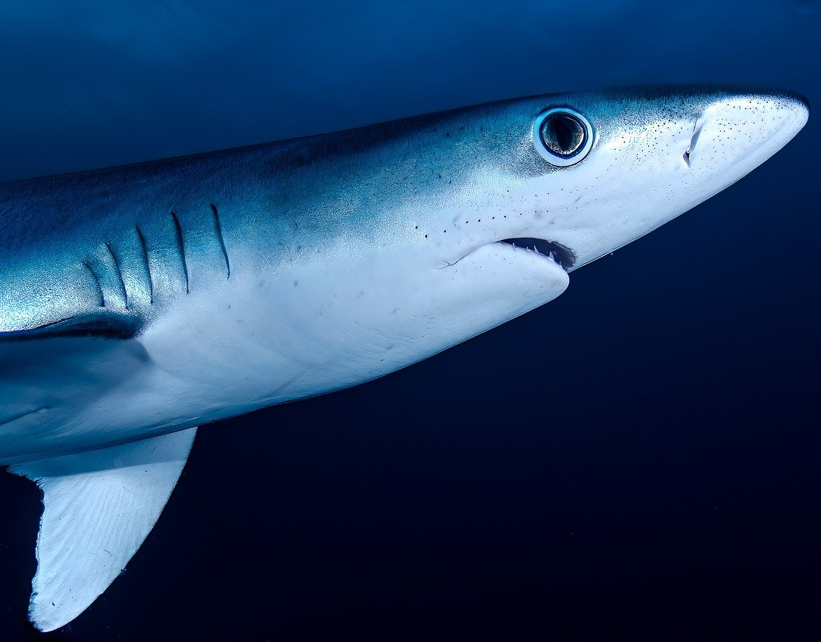
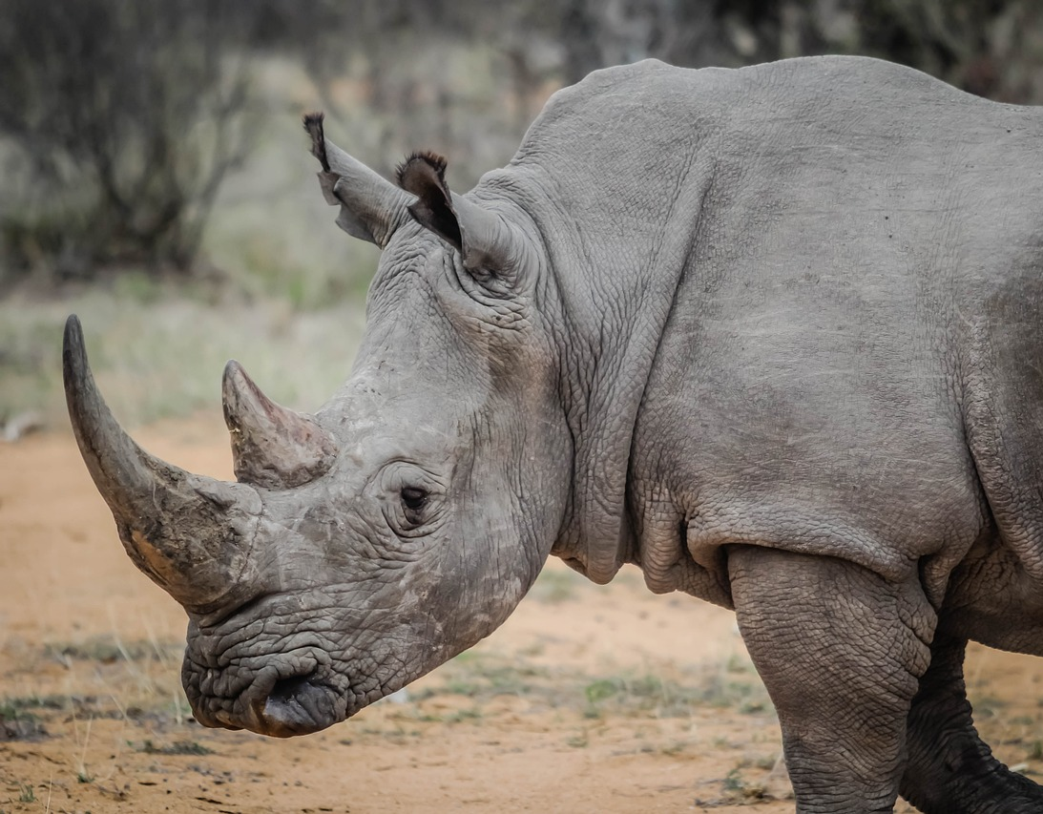
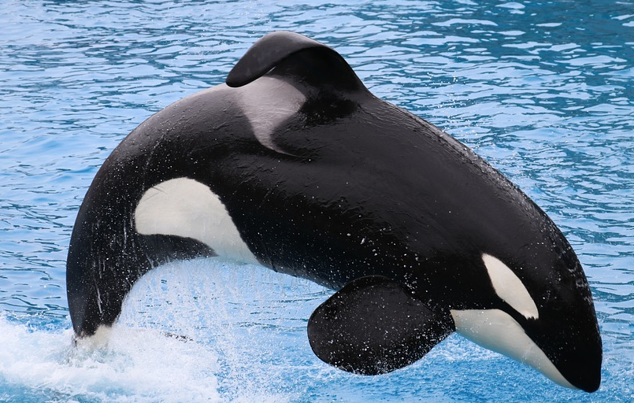
Groups within vertebrates and invertebrates
All of these animals belong to the same group except one. Can you spot which one?
bat
shark
rhinoceros
orca
The shark doesn’t belong in this group.
The rest of these animals are mammals.

Slide 24
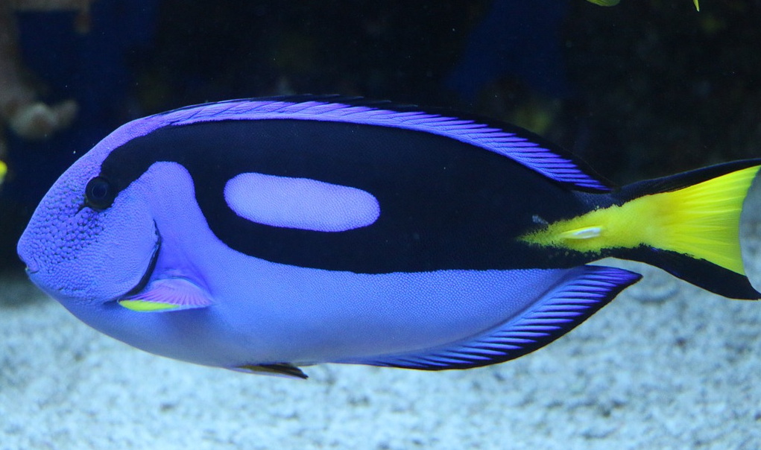
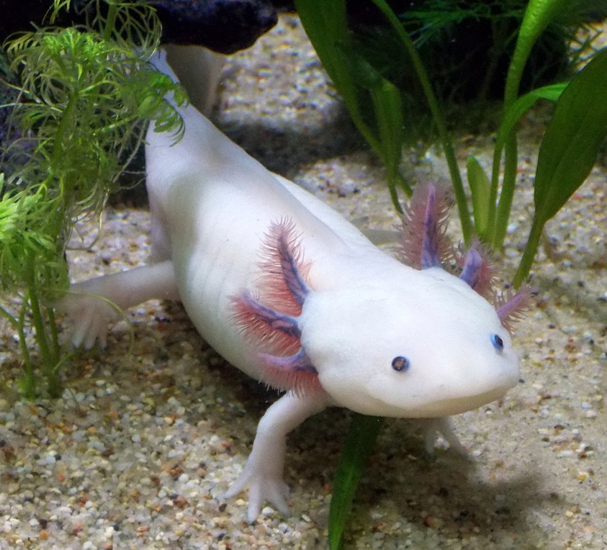
Groups within vertebrates and invertebrates
All of these animals belong to the same group except one. Can you spot which one?
tang
shark
eel
axolotl
The axolotl doesn’t belong in this group.
The rest of these animals are fish.

Slide 25
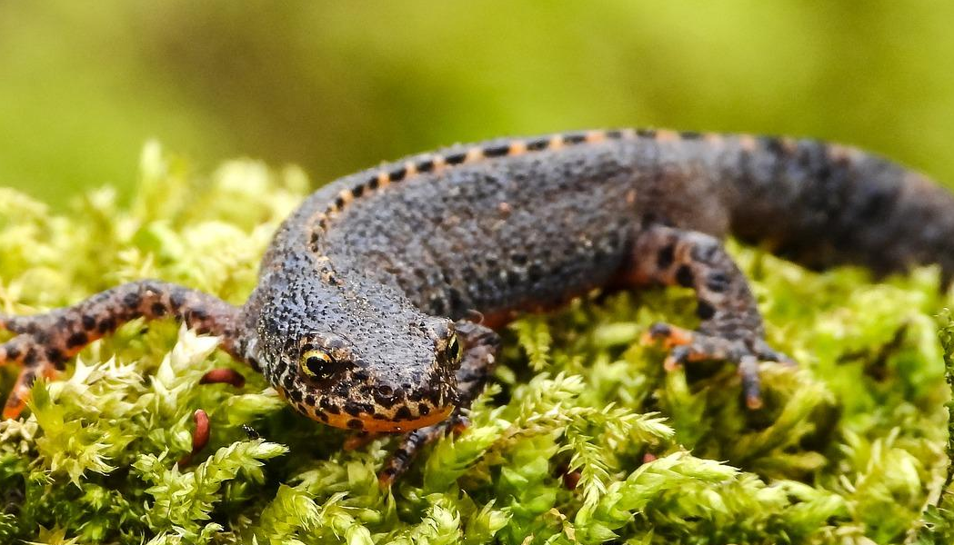
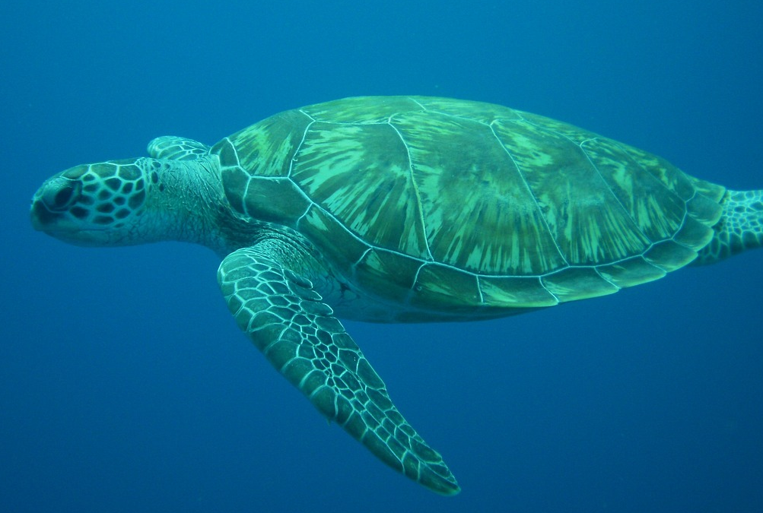
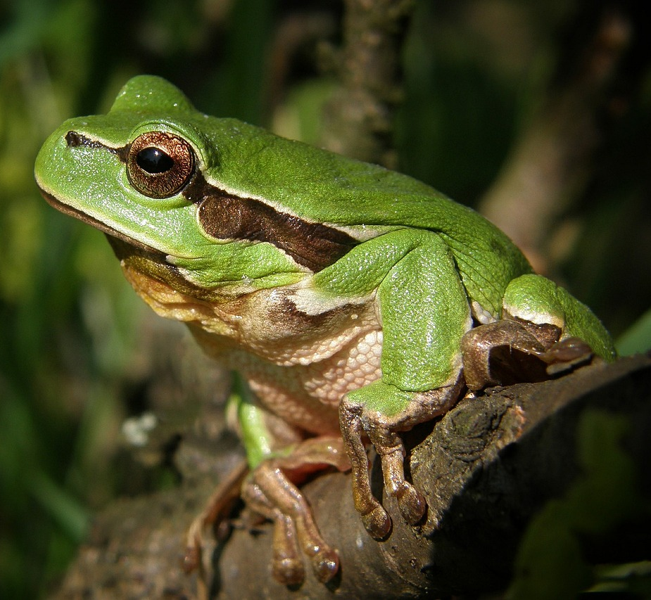
Groups within vertebrates and invertebrates
All of these animals belong to the same group except one. Can you spot which one?
axolotl
newt
turtle
frog
The turtle doesn’t belong in this group.
The rest of these animals are amphibians.

Slide 26
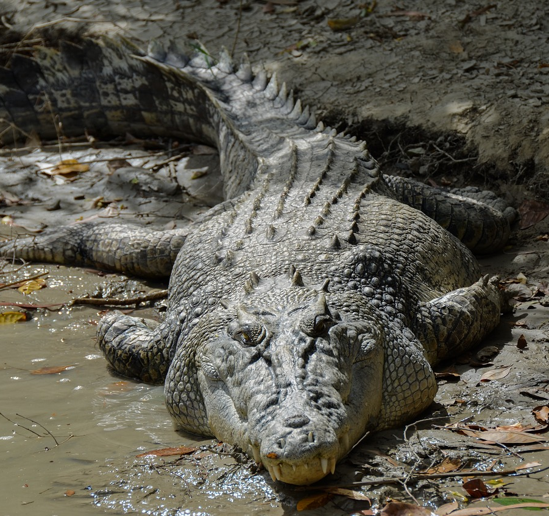


Groups within vertebrates and invertebrates
All of these animals belong to the same group except one. Can you spot which one?
turtle
crocodile
chameleon
armadillo
The armadillo doesn’t belong in this group.
The rest of these animals are reptiles.

Slide 27





Groups within vertebrates and invertebrates
Which vertebrate group do these animals belong to?
a
rabbit
mammal
lizard
reptile
c
toad
amphibian
b
d
swan
bird
e
salmon
fish

Slide 28




Groups within vertebrates and invertebrates
Invertebrates can also be classified into further groups, including insects, arachnids, crustaceans and molluscs.
invertebrates

Slide 29




Groups within vertebrates and invertebrates
Insects have six legs, a body divided into three segments and a pair of antennae.
Some common insects are beetles, bees, butterflies and ants.
beetle
honeybee
butterfly
ant

Slide 30

Groups within vertebrates and invertebrates
Arachnids have eight legs and a body divided into two sections.
Some common arachnids are spiders, harvestmen, scorpions and ticks.
spider
harvestman
scorpion
tick

Slide 31


Groups within vertebrates and invertebrates
Crustaceans have a hard exoskeleton and two pairs of antennae.
Some common crustaceans include crabs, lobsters, shrimp and barnacles.
crab
lobster
shrimp
barnacles

Slide 32
Groups within vertebrates and invertebrates
Molluscs have a very soft body. They have hydrostatic skeletons. Some also have shells.
Some common molluscs include slugs, snails, squid and octopuses.
slug
snail
squid
octopus

Slide 33
Groups within vertebrates and invertebrates
Complete the sentences using the correct groups.
insects arachnids crustaceans molluscs
Crustaceans
Arachnids
Molluscs
Insects
___have two pairs of antennae and a hard exoskeleton.
__ have a body in two sections and eight legs.
_ have a very soft body and some have shells.
have six legs and a body divided into three sections.

Slide 34
Groups within vertebrates and invertebrates
We can use classification keys to help us identify unfamiliar animals.
Does it have wings?
Classification keys have a series of yes / no questions about the observable characteristics of living things.
yes
no
Does it have feathers?
Does it have a shell?
yes
no
yes
no
Each question leads you to a new question until you identify the living thing.
robin
butterfly
snail
slug
classification key

Slide 35
Groups within vertebrates and invertebrates
Which of these questions could not be used on a classification key?
a
Does it have feathers?
b
How many legs does it have?
c
Can it breathe underwater?
d
Does it have sharp claws?
e
Is it furry?

Slide 36





Groups within vertebrates and invertebrates
Use the classification key to identify the invertebrates.
1)
2)
3)
4)
5)

Slide 37
Groups within vertebrates and invertebrates
Does the animal have legs?
yes
no
Does the animal have antennae?
Does the animal have a spotty pattern on its skin?
yes
no
yes
no
Is the animal green?
wasp spider (arachnid)
sea snail (mollusc)
cuttlefish (mollusc)
yes
no
praying mantis (insect)
woodlouse (crustacean)

Slide 38
Groups within vertebrates and invertebrates
Use the classification key to identify the invertebrates.
1) wasp spider (arachnid)
2) sea snail (mollusc)
3) praying mantis (insect)
4) woodlouse (crustacean)
5) cuttlefish (mollusc)

Slide 39
How and why we group animals
Vertebrates and invertebrates
Groups within vertebrates and invertebrates
Creating classification keys

Slide 40




Creating classification keys
We can use our knowledge of similarities and differences between animals to create classification keys.
Sofia has five invertebrates that she found in the school grounds and would like to create a classification key to help other children identify them and learn more about invertebrate groups.
Sofia
Sofia’s invertebrates

Slide 41
Creating classification keys
What are the observable characteristics of the animals Sofia has found?
bee
spider
snail
ant
slug
We can use these to create a classification key.

Slide 42

Creating classification keys
To create a classification key, first we need to ask a yes / no question that will divide these animals into two groups, based on their observable characteristics.
Does the animal have legs?
Does the animal have legs?
Sofia
yes
no
bee
spider
ant
snail
slug

Slide 43
Creating classification keys
Sofia still has more than one animal at the end of each branch of her key.
She asks another question to divide the group on the ‘no’ branch.
Does the animal have legs?
Does the animal have a shell?
yes
no
Does the animal have a shell?
bee
spider
ant
yes
no
Sofia
snail
slug

Slide 44
Creating classification keys
Sofia continues asking questions until she has only one animal left at the end of each branch.
Does the animal have legs?
yes
no
Does the animal have wings?
Does the animal have a shell?
yes
no
yes
no
snail
slug
bee
spider
ant

Slide 45
Creating classification keys
Does the animal have legs?
yes
no
Does the animal have wings?
Does the animal have a shell?
yes
no
yes
no
bee
Is the body divided into two sections?
snail
slug
yes
no
spider
ant

Slide 46
Creating classification keys
Here is my classification key.
Does the animal have legs?
yes
no
Does the animal have wings?
Does the animal have a shell?
Sofia
yes
no
yes
no
bee
Is the body divided into two sections?
snail
slug
yes
no
spider
ant

Slide 47




Creating classification keys
Which question could we use to divide these animals into two groups?
Does it have four legs?
horse
cat
Can it walk?
Is it a vertebrate?
chicken
human
How does it find food?

Slide 48
Creating classification keys
Which question could we use for the last branch of this classification key?
horse
human
chicken
cat
a
Does it have two legs?
Does it have 4 legs?
yes
no
How many wings does it have?
b
Does it have hooves?
?
yes
no
Does it have an internal skeleton?
c
horse
cat
d
Does it have feathers?

Slide 49



Creating classification keys
Choose 4 - 6 of these animals and create a classification key to help others identify them.
red ghost crab (crustacean)
octopus (mollusc)
scorpion (arachnid)
red admiral butterfly (insect)
tang (fish)
kingfisher (bird)
python (reptile)
poison dart frog (amphibian)

Slide 50

Creating classification keys
Choose 4 - 6 of these animals and create a classification key to help others identify them.
Does the animal have wings?
Here is my classification key. Is yours similar?
yes
no
Does the animal have antennae?
Does the animal have an exoskeleton?
yes
no
yes
no
red admiral butterfly (insect)
kingfisher (bird)
red ghost crab (crustacean)
octopus (mollusc)
Alex

Slide 51
How and why we group animals
Scientists classify animals to make it easier to identify, name and learn about them.
Animals can be classified by looking at similarities and differences in their observable characteristics.
Animals can be divided into vertebrates and invertebrates, then grouped again within these categories.
We can create classification keys for animals by asking a series of yes / no questions about their observable characteristics.

